Slide 1
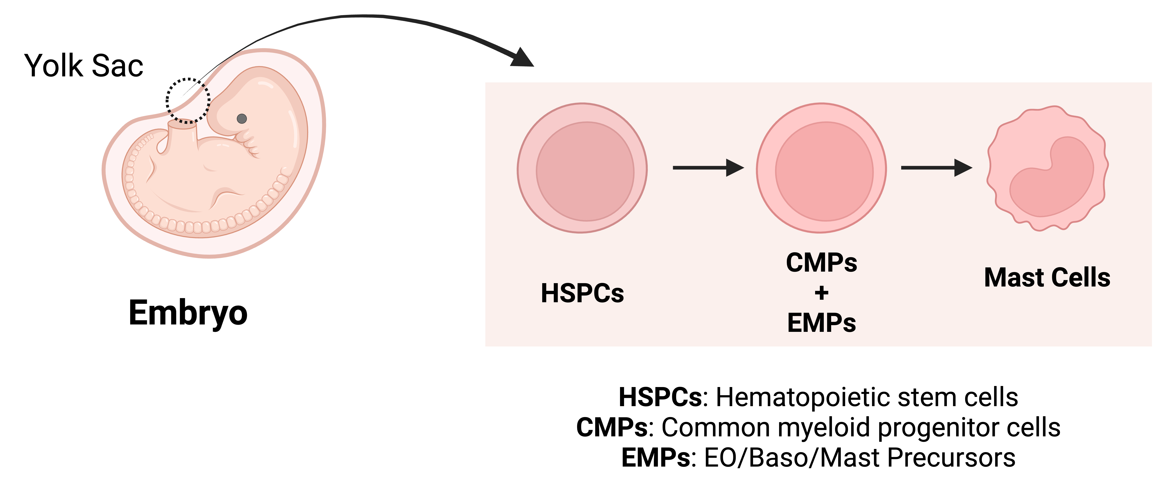
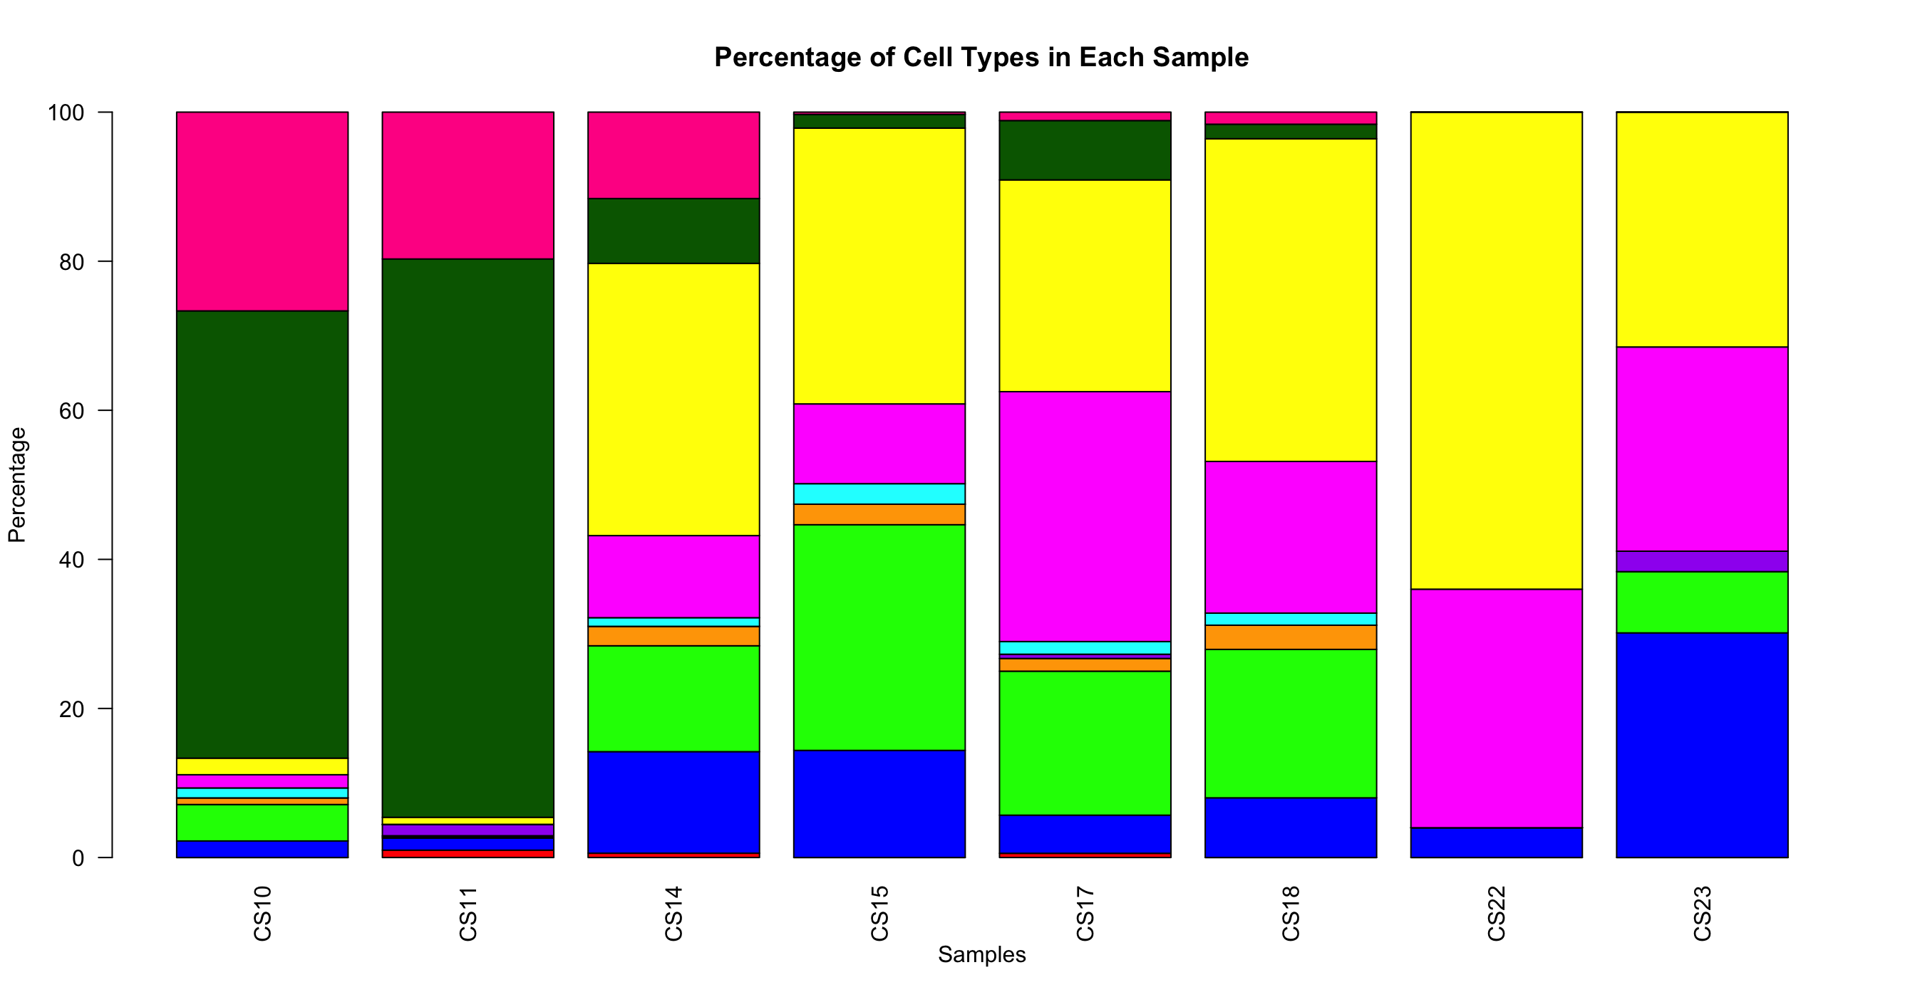
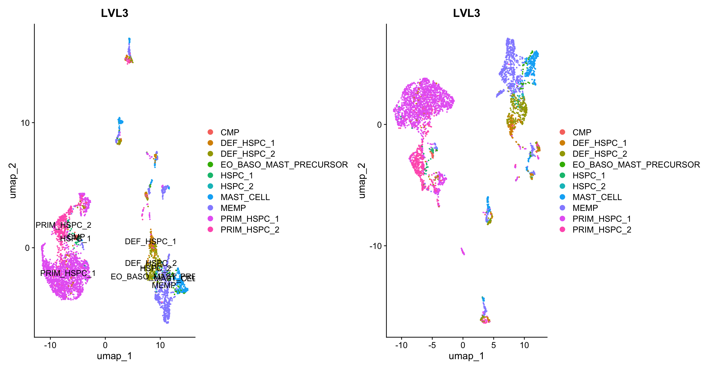
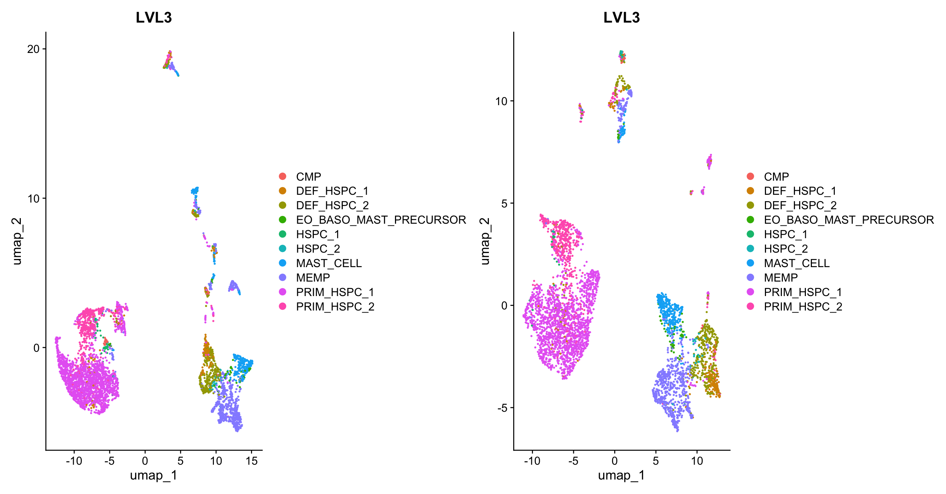
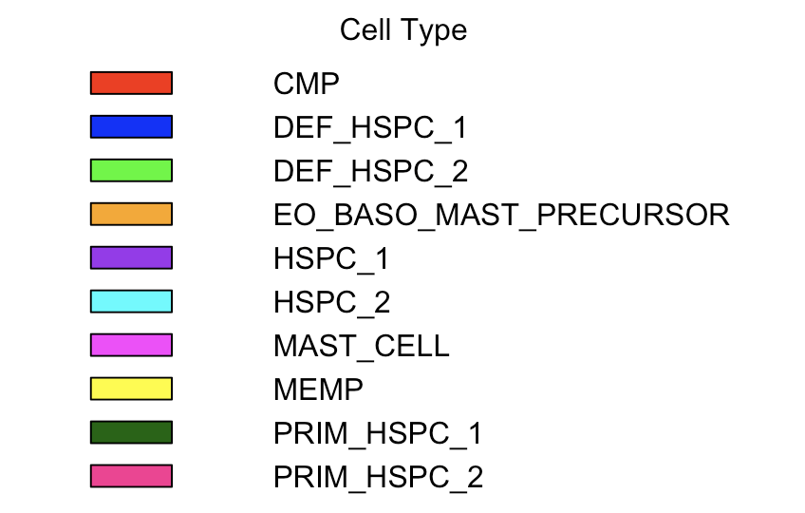
A
B
Ratio of cells expressed In Each Stage of Development
% of Cells
Not Integrated
Integrated Using Harmony
C
Stage of Development
Cell Types (C)
Cell Types (B)

Slide 2
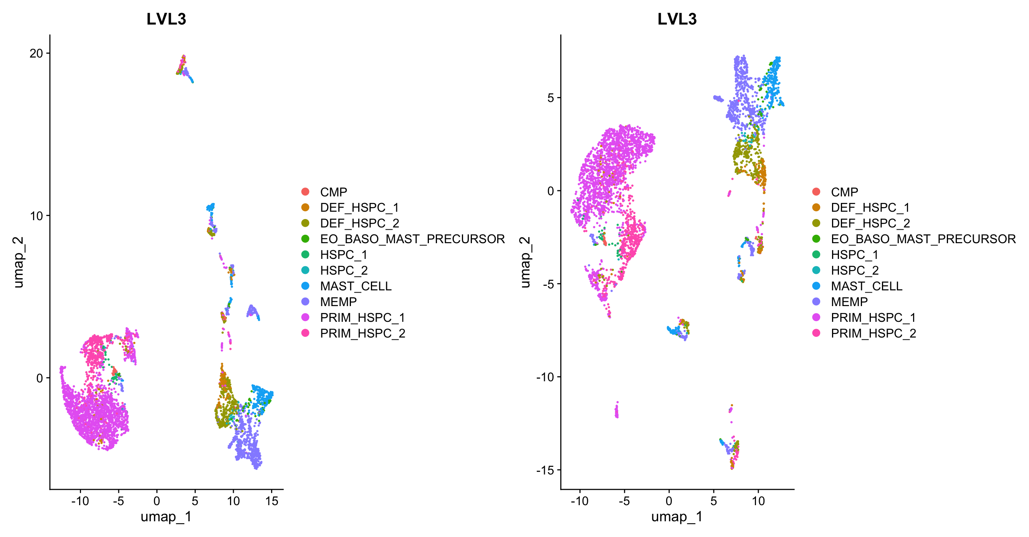
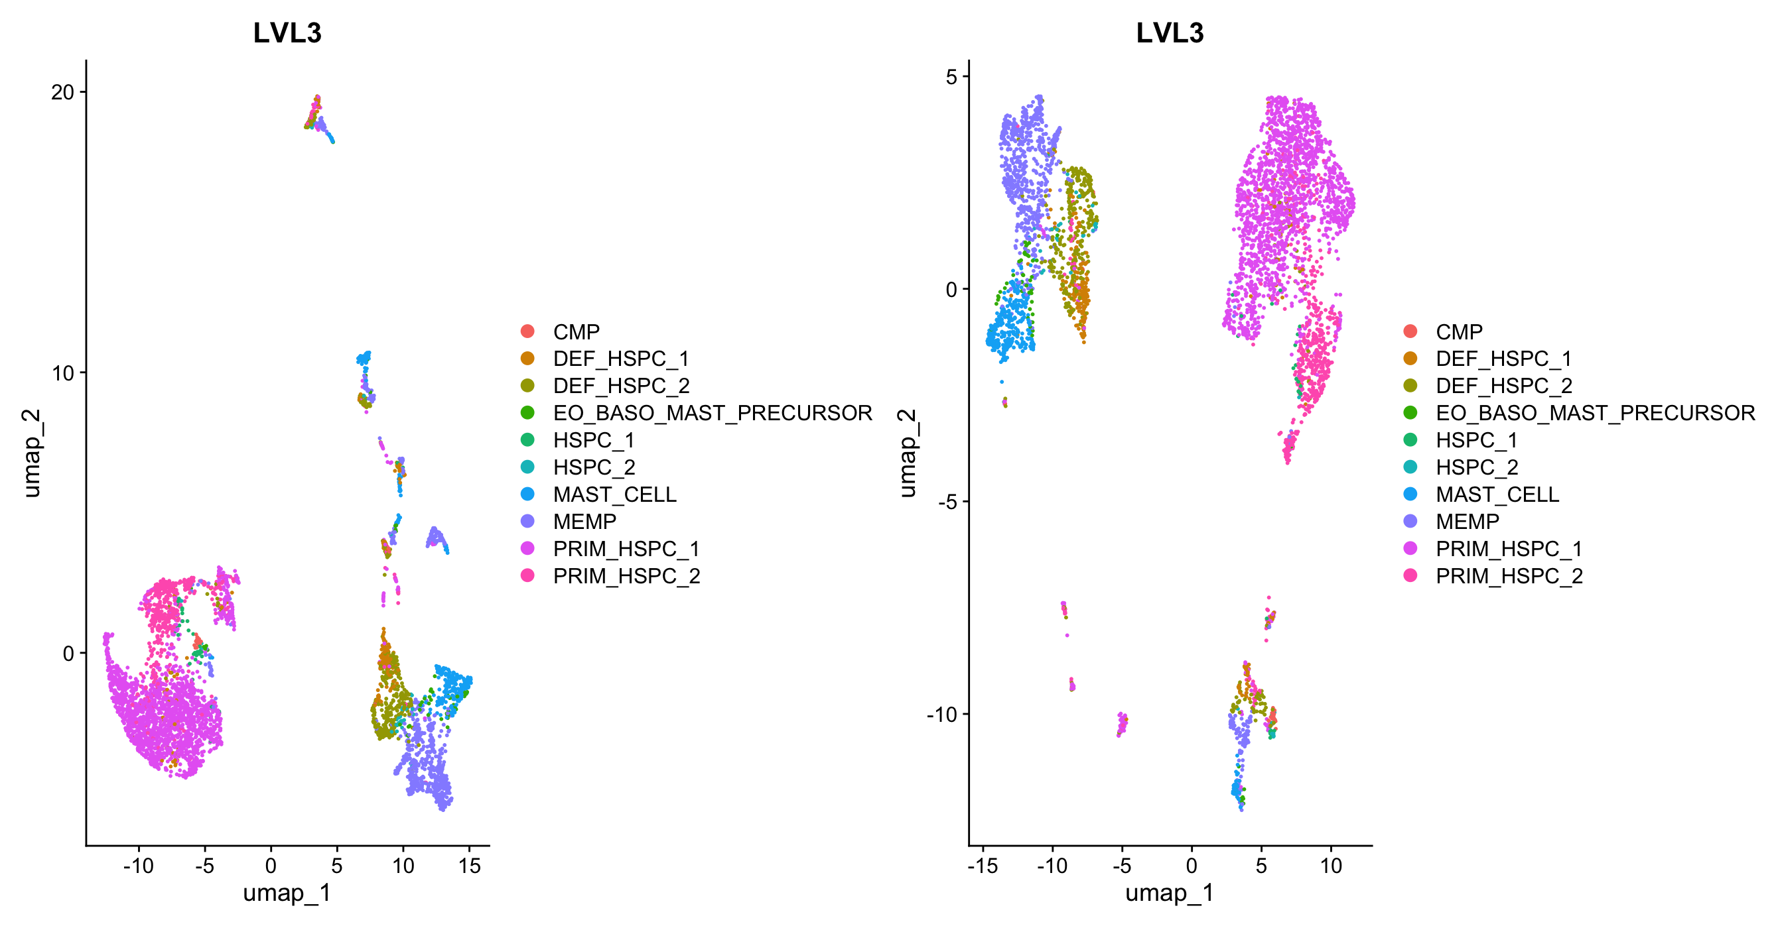
A
B
Ratio of cells expressed In Each Stage of Development
% of Cells
Not Integrated
Integrated Using Harmony
C
Stage of Development
Cell Types (C)
Cell Types (B)

Slide 3
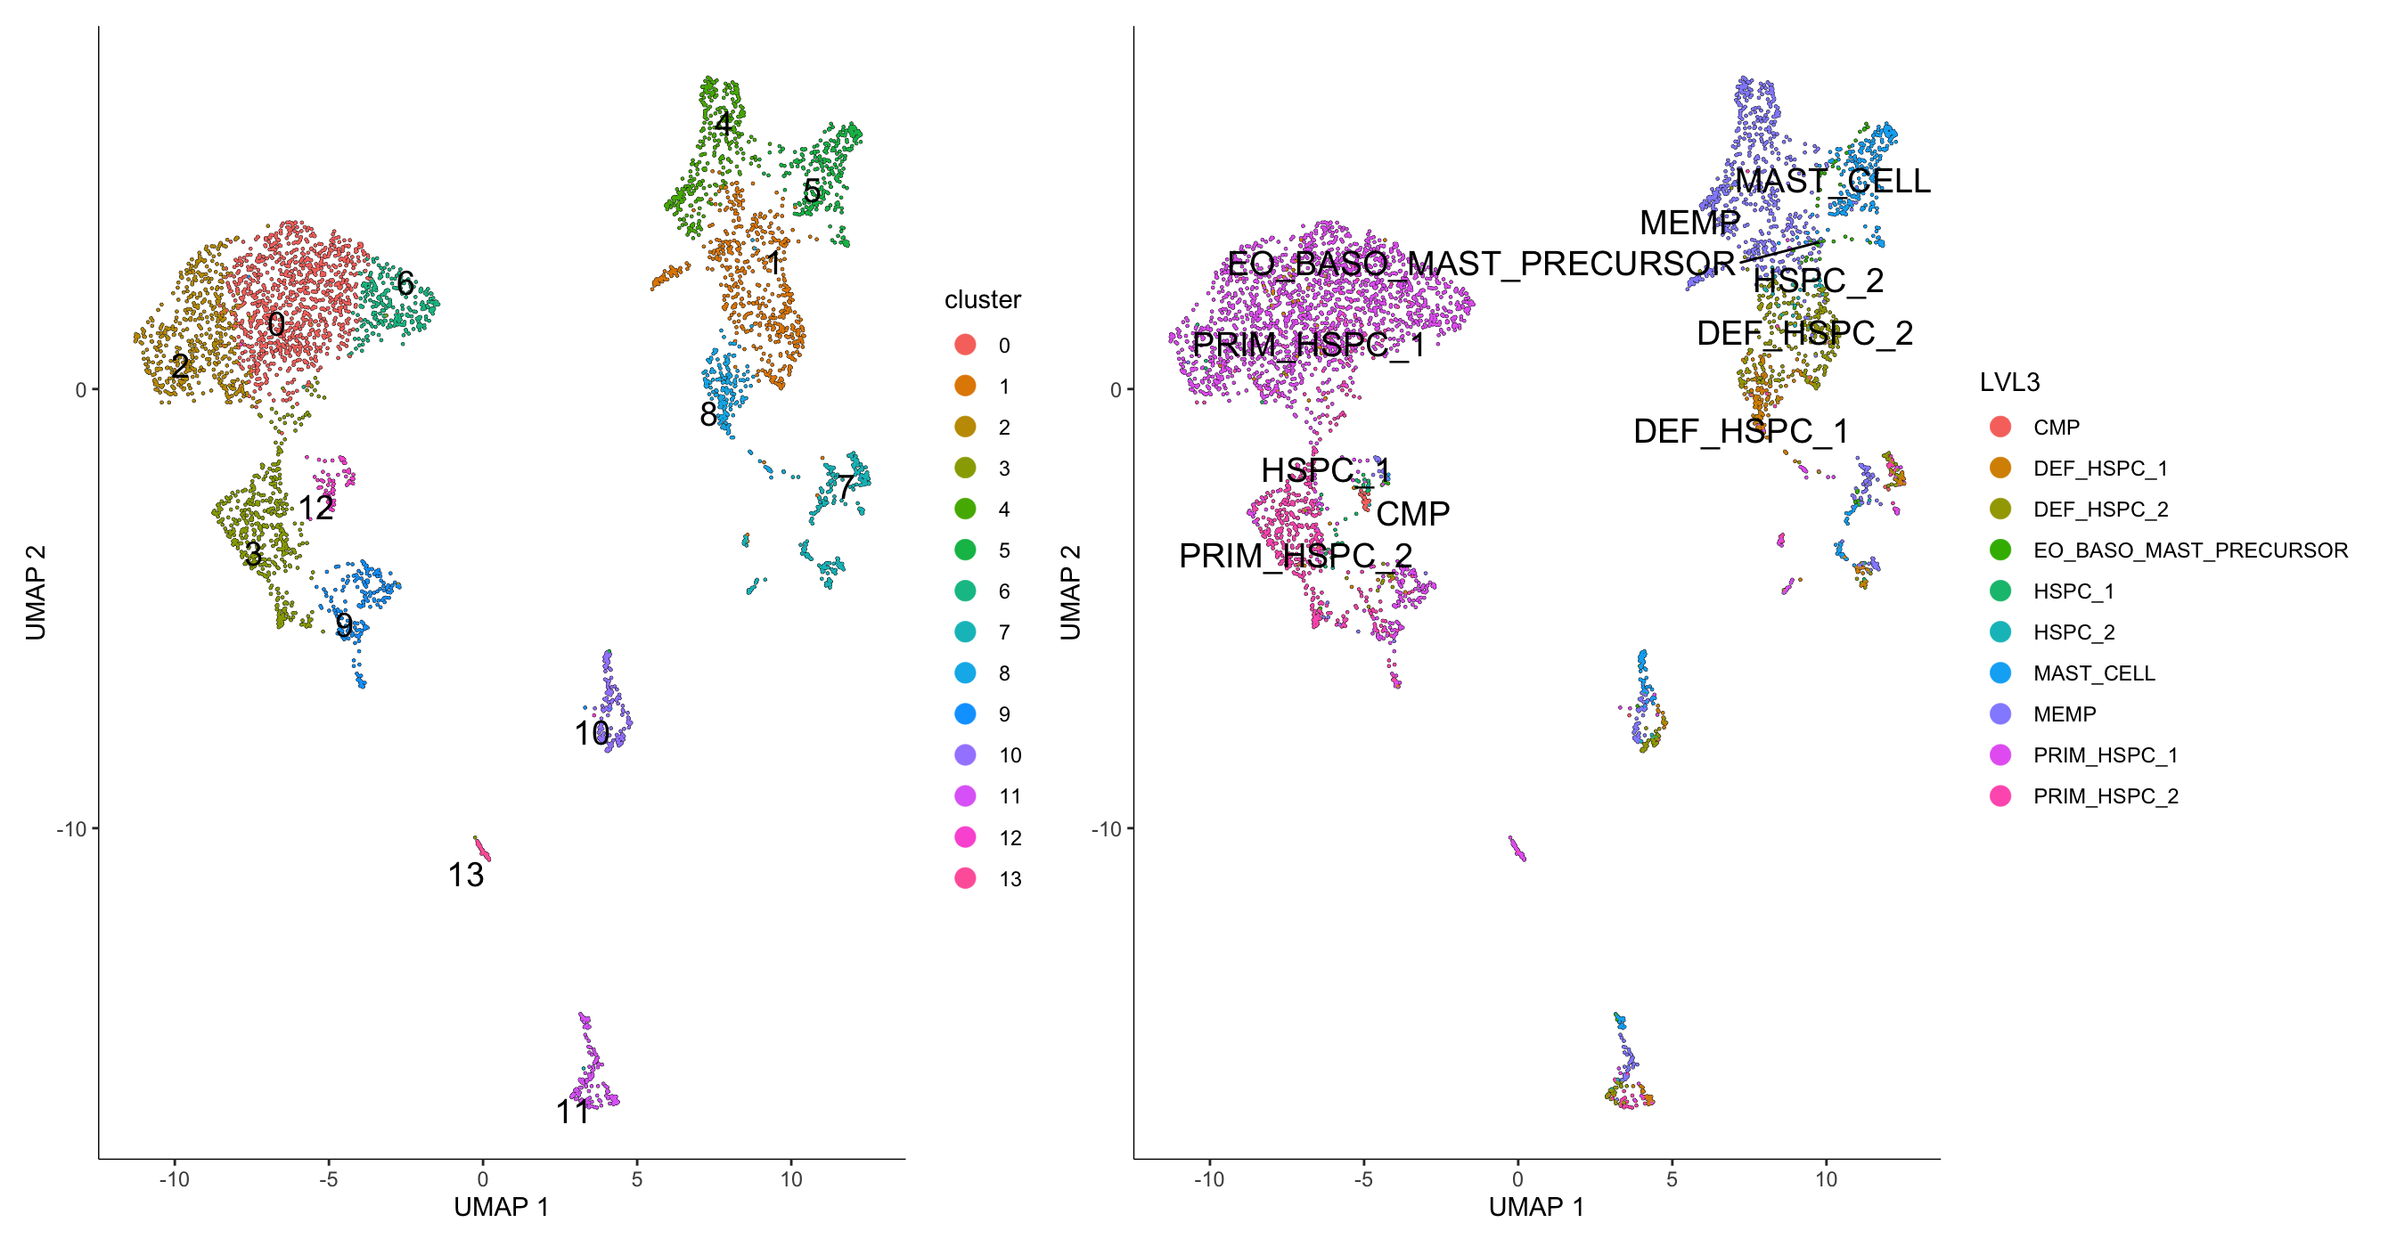
Notes:
Figure x: Overview of clustering and cell types in yolk sac data set for pseudotime trajectory. A) Mast cell differentiation overview. B) Overview of the % of each cell type based on Carnegie stage of development. C) UMAPs of clustering before and after integration.

Slide 4
Notes:
Figure x: Overview of clustering and cell types in yolk sac data set for pseudotime trajectory. A) Mast cell differentiation overview. B) Overview of the % of each cell type based on Carnegie stage of development. C) UMAPs of clustering before and after integration.

Slide 5
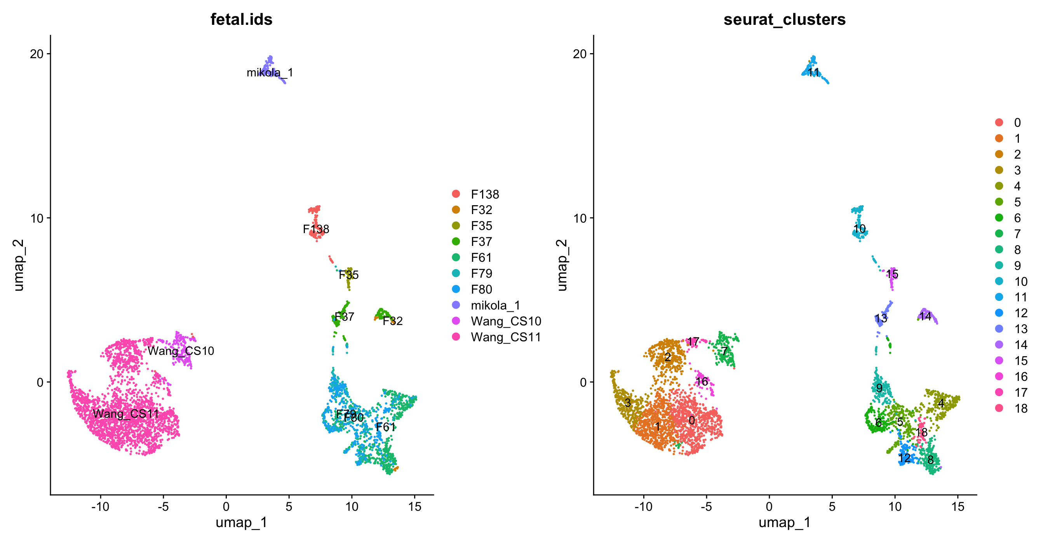
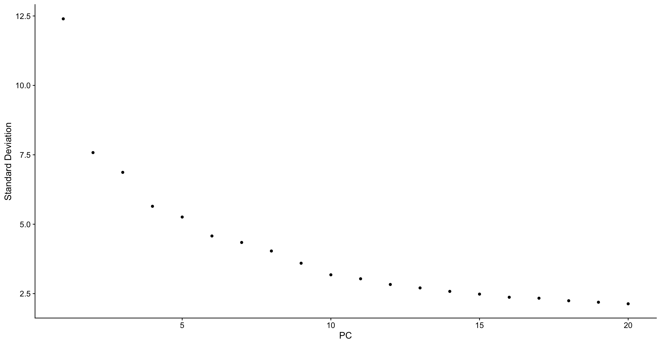
A
C
D
Ratio of cells expressed In Each Stage of Development
B
% of Cells
Stage of Development

Slide 6
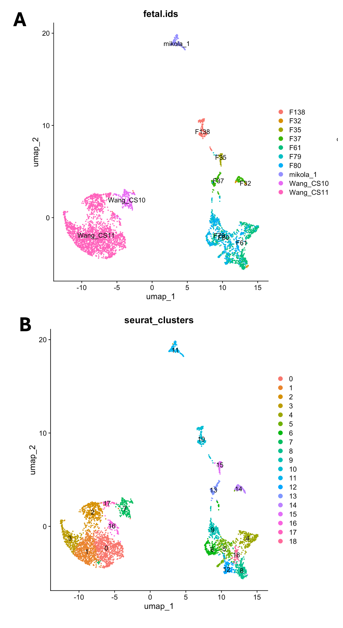

Slide 7
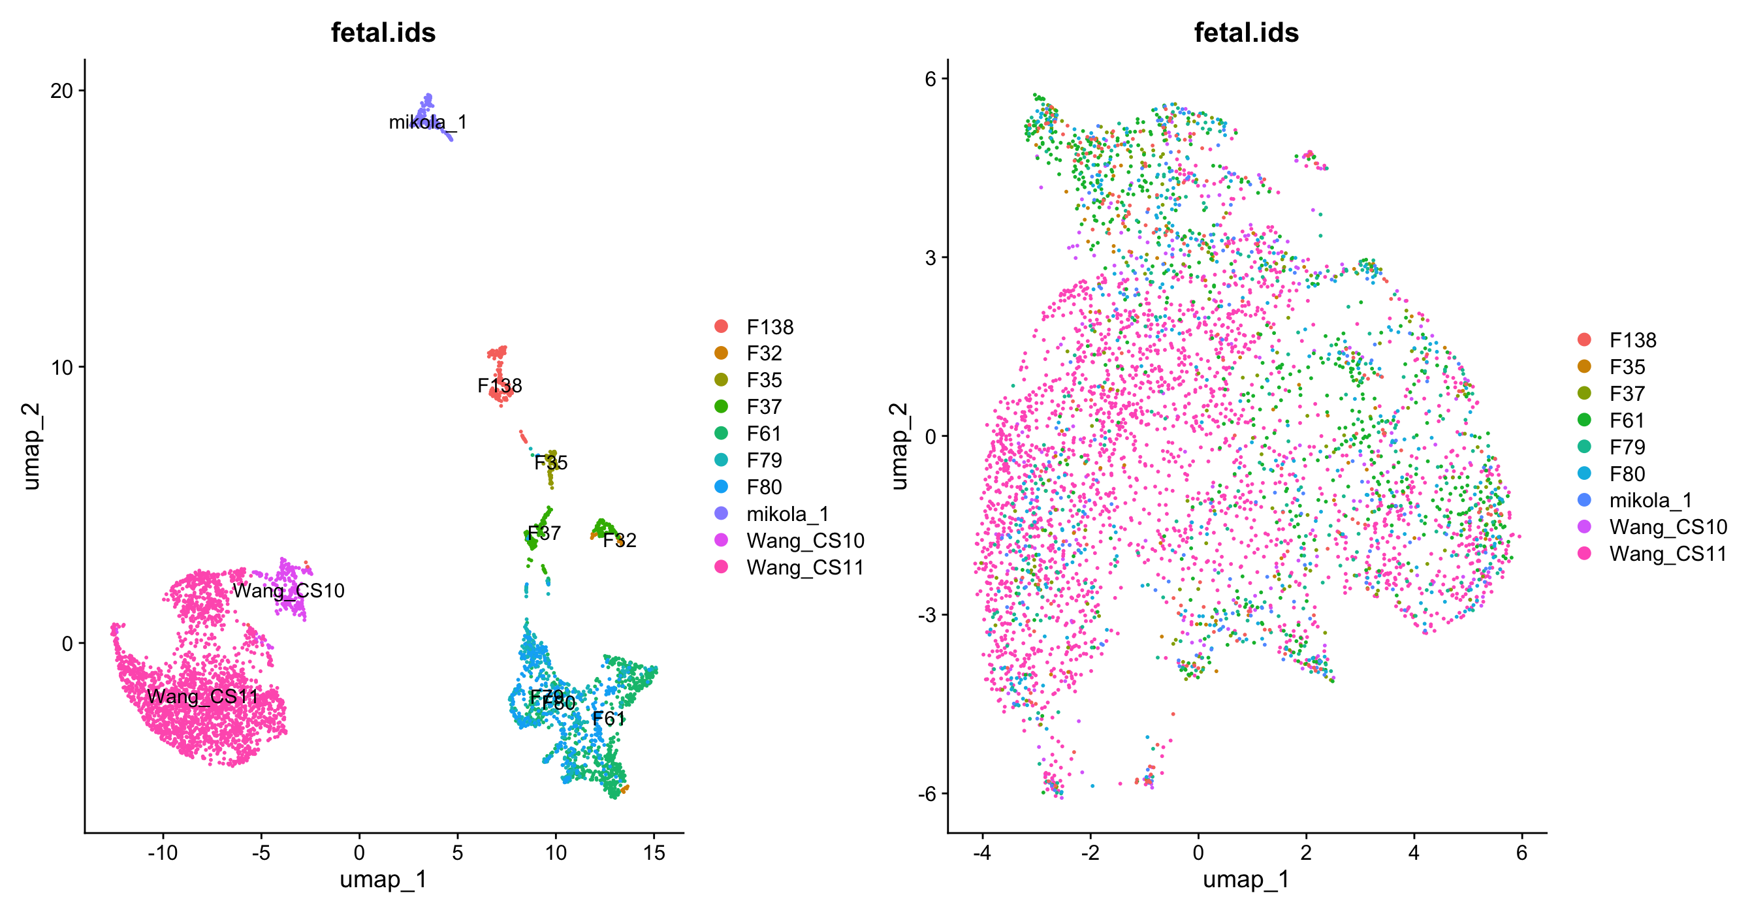
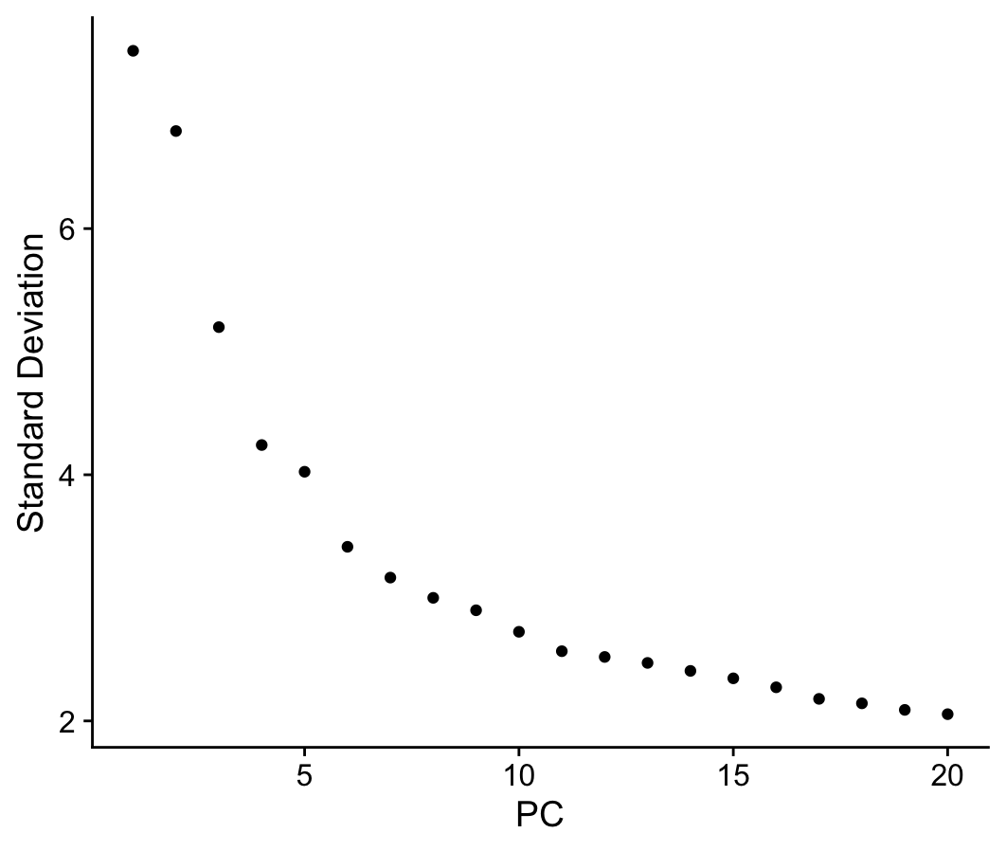
A
B
C

Slide 8
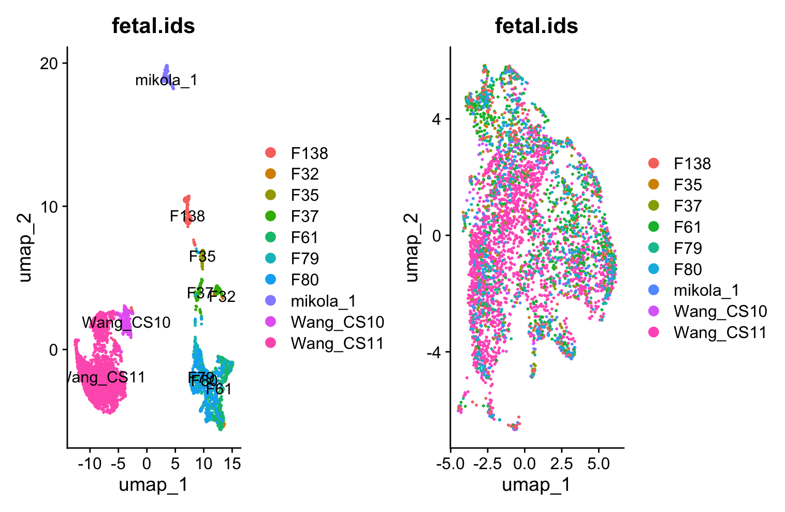
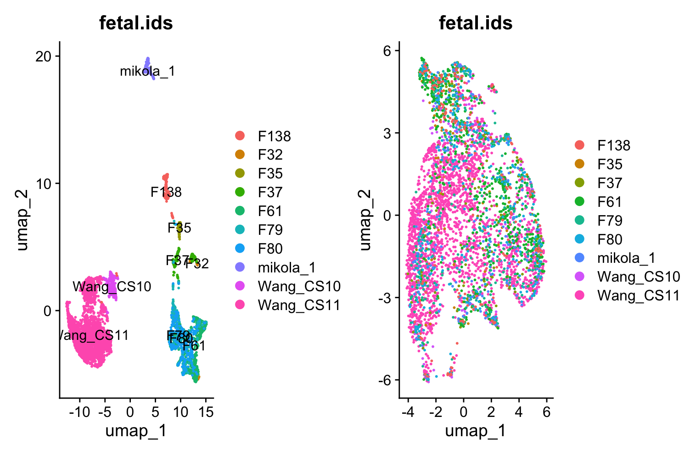
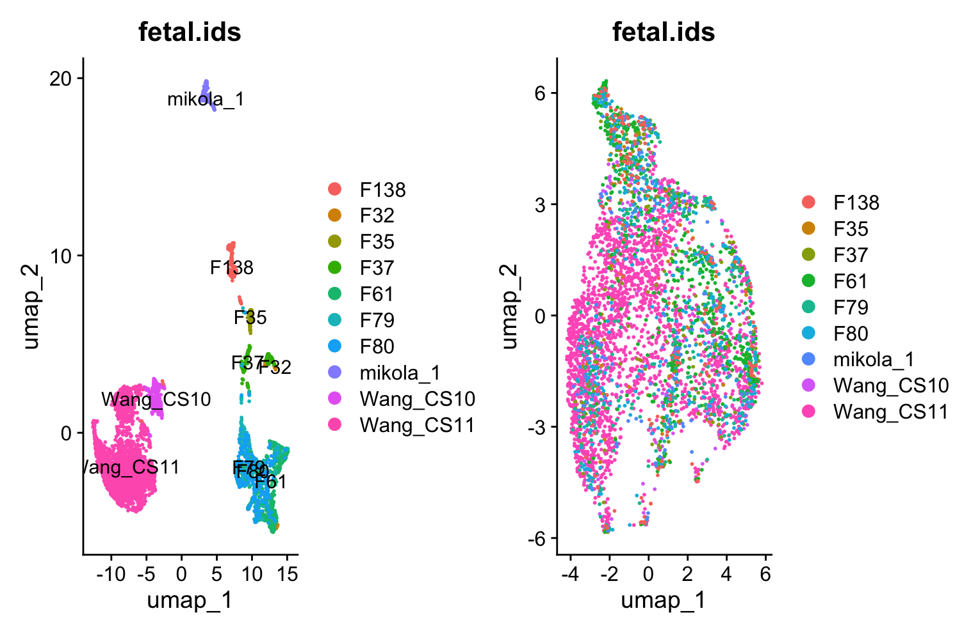
A
B
C
k.Weight = 20
k.Weight = 50
k.Weight = 70

Slide 9
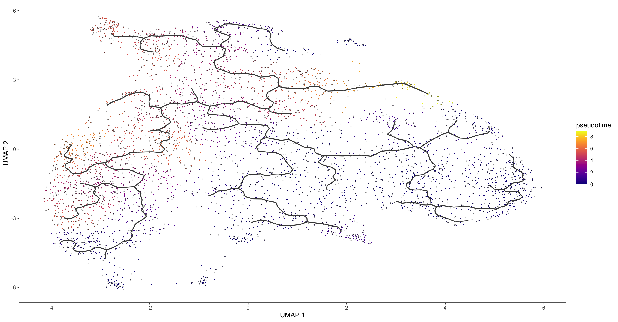
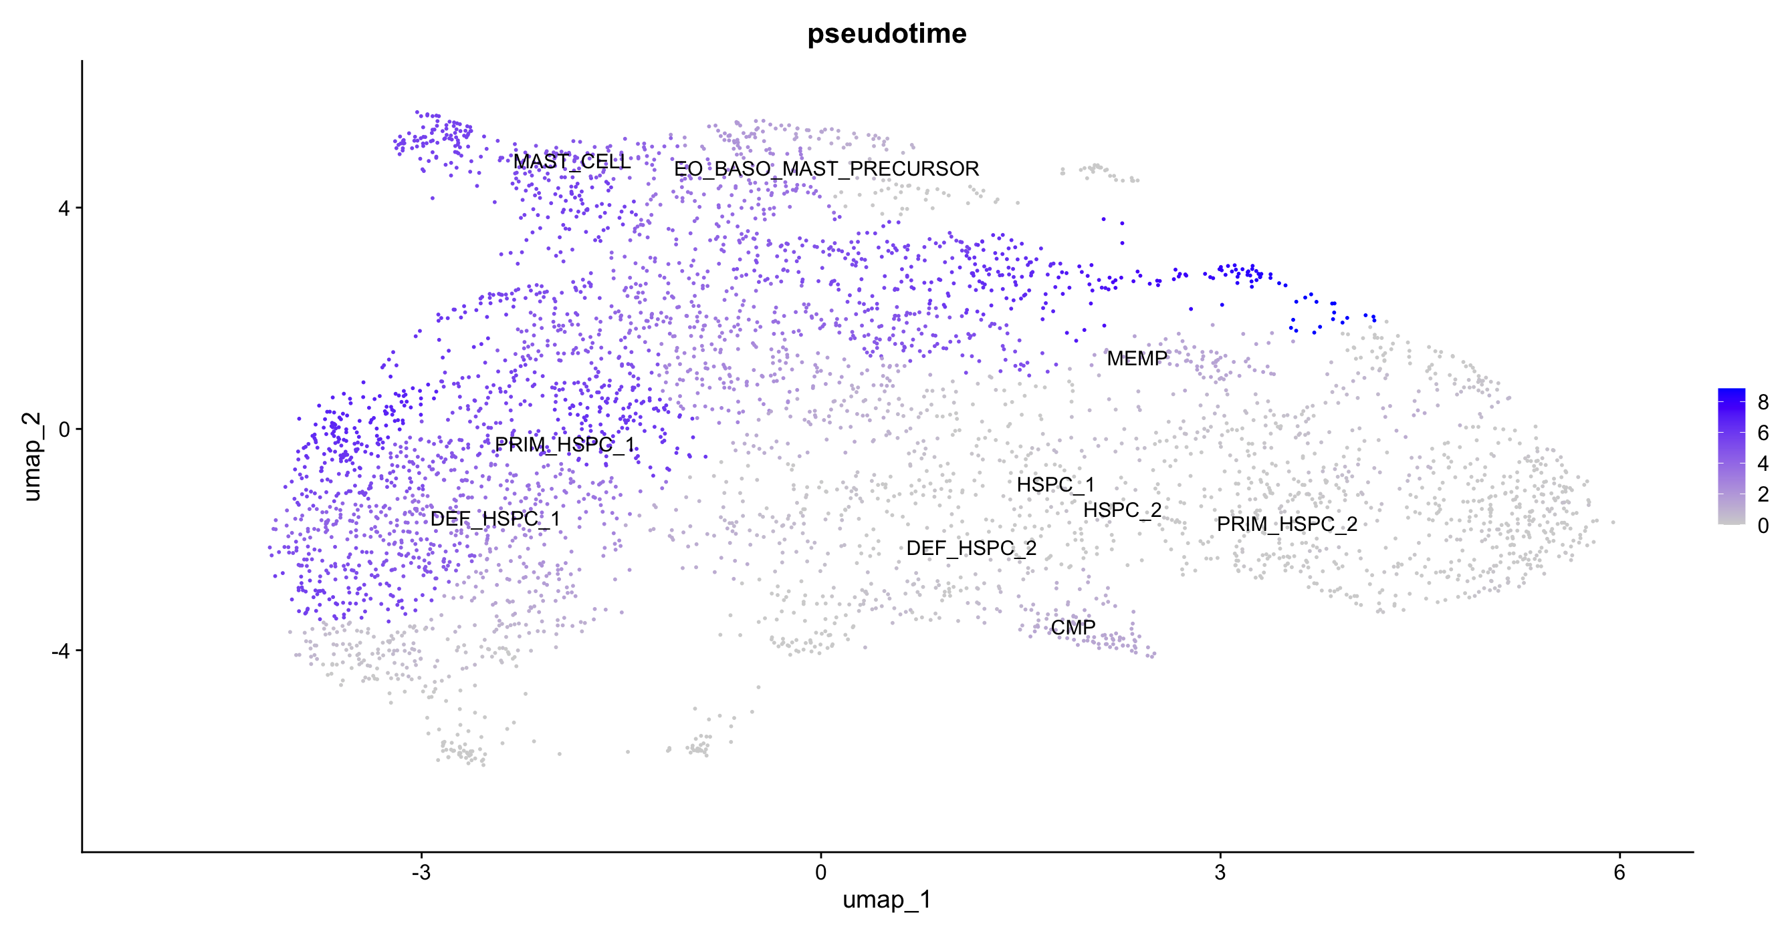
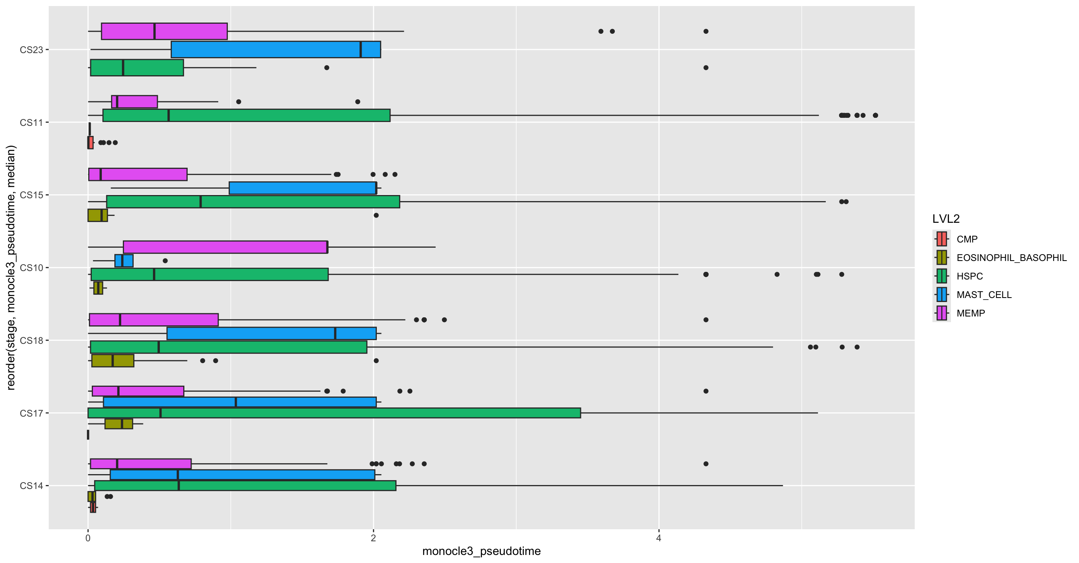
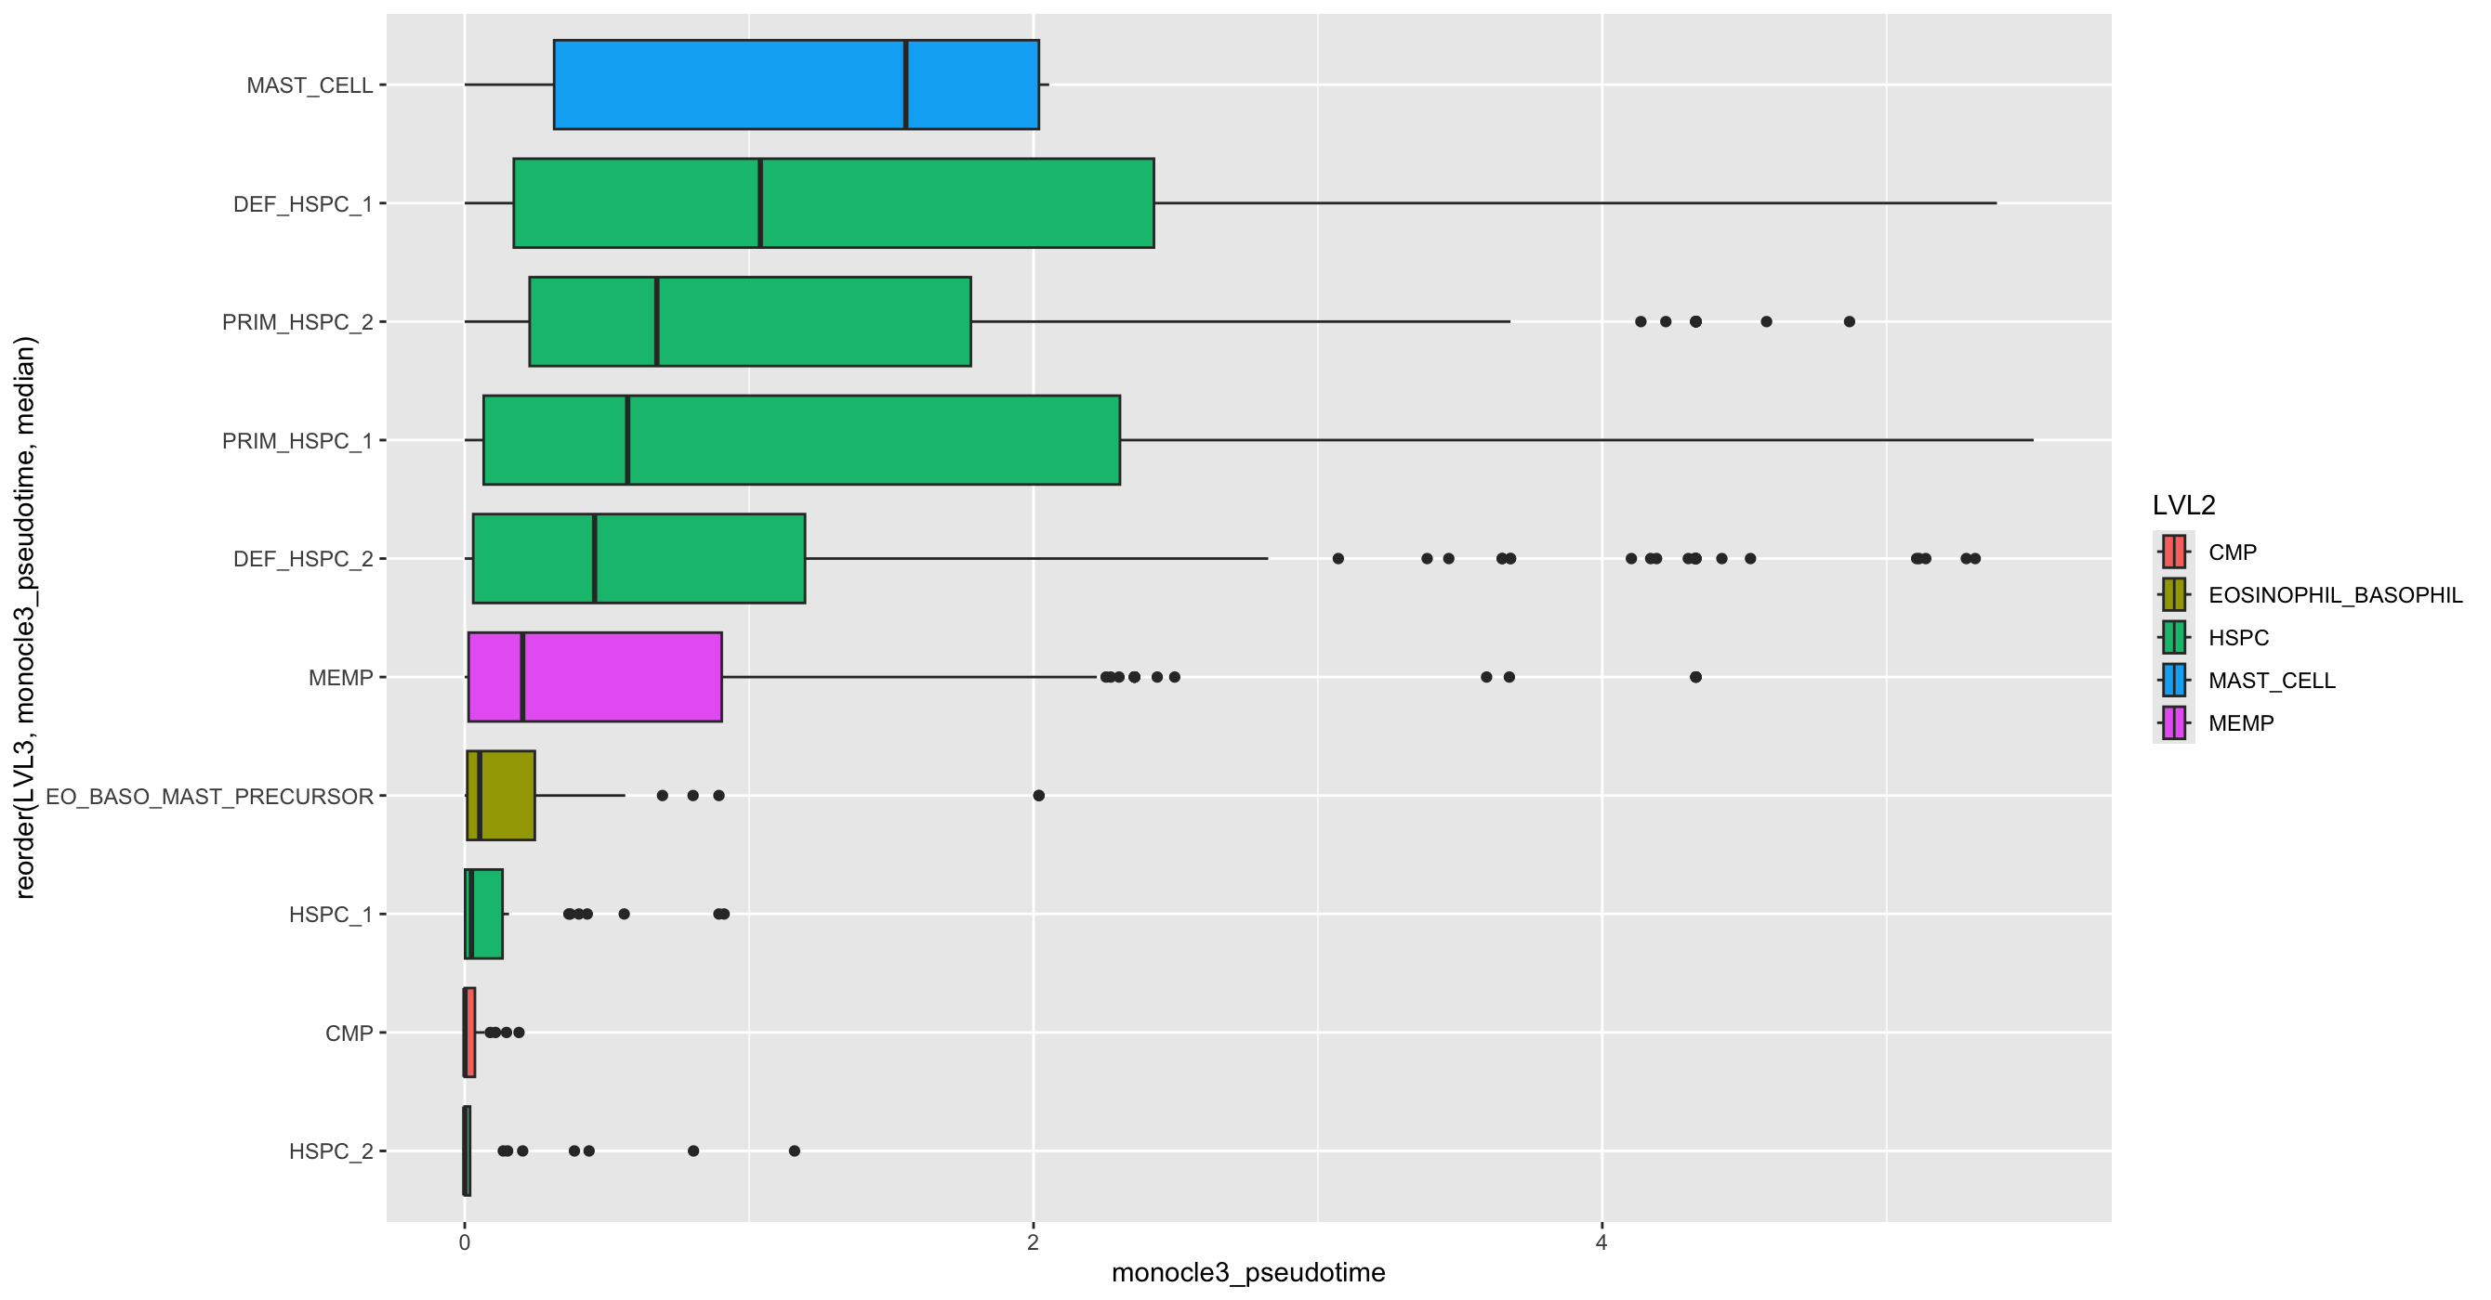
A
B
C
D

Slide 10
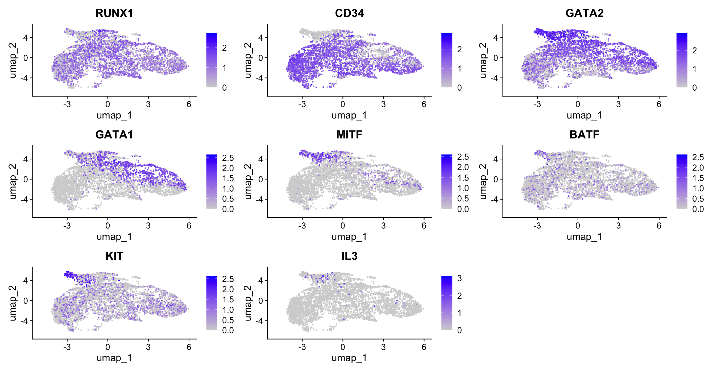
A
RUNX1 = transcription factor involved in hematopoiesis
CD34 = cell surface glycoprotein expressed on hematopoietic stem cells and progenitor cells
GATA1 = transcription factor that plays a critical role in erythropoiesis and megakaryopoiesis
GATA2 = Transcription factor involved in hematopoiesis, lymphangiogenesis, and vascular development
MITF = Microphthalmia-associated transcription factor) is a transcription factor that plays a critical role in the development and function of melanocytes, osteoclasts, and mast cells
BATF = (Basic leucine zipper ATF-like transcription factor) is a transcription factor involved in immune regulation
KIT = receptor tyrosine kinase involved in the regulation of cell survival, proliferation, and differentiation, particularly in hematopoietic stem cells, mast cells, and germ cells

Slide 11
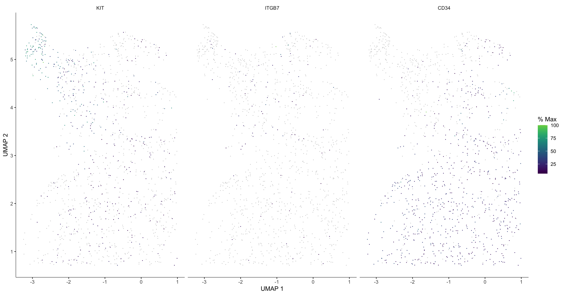
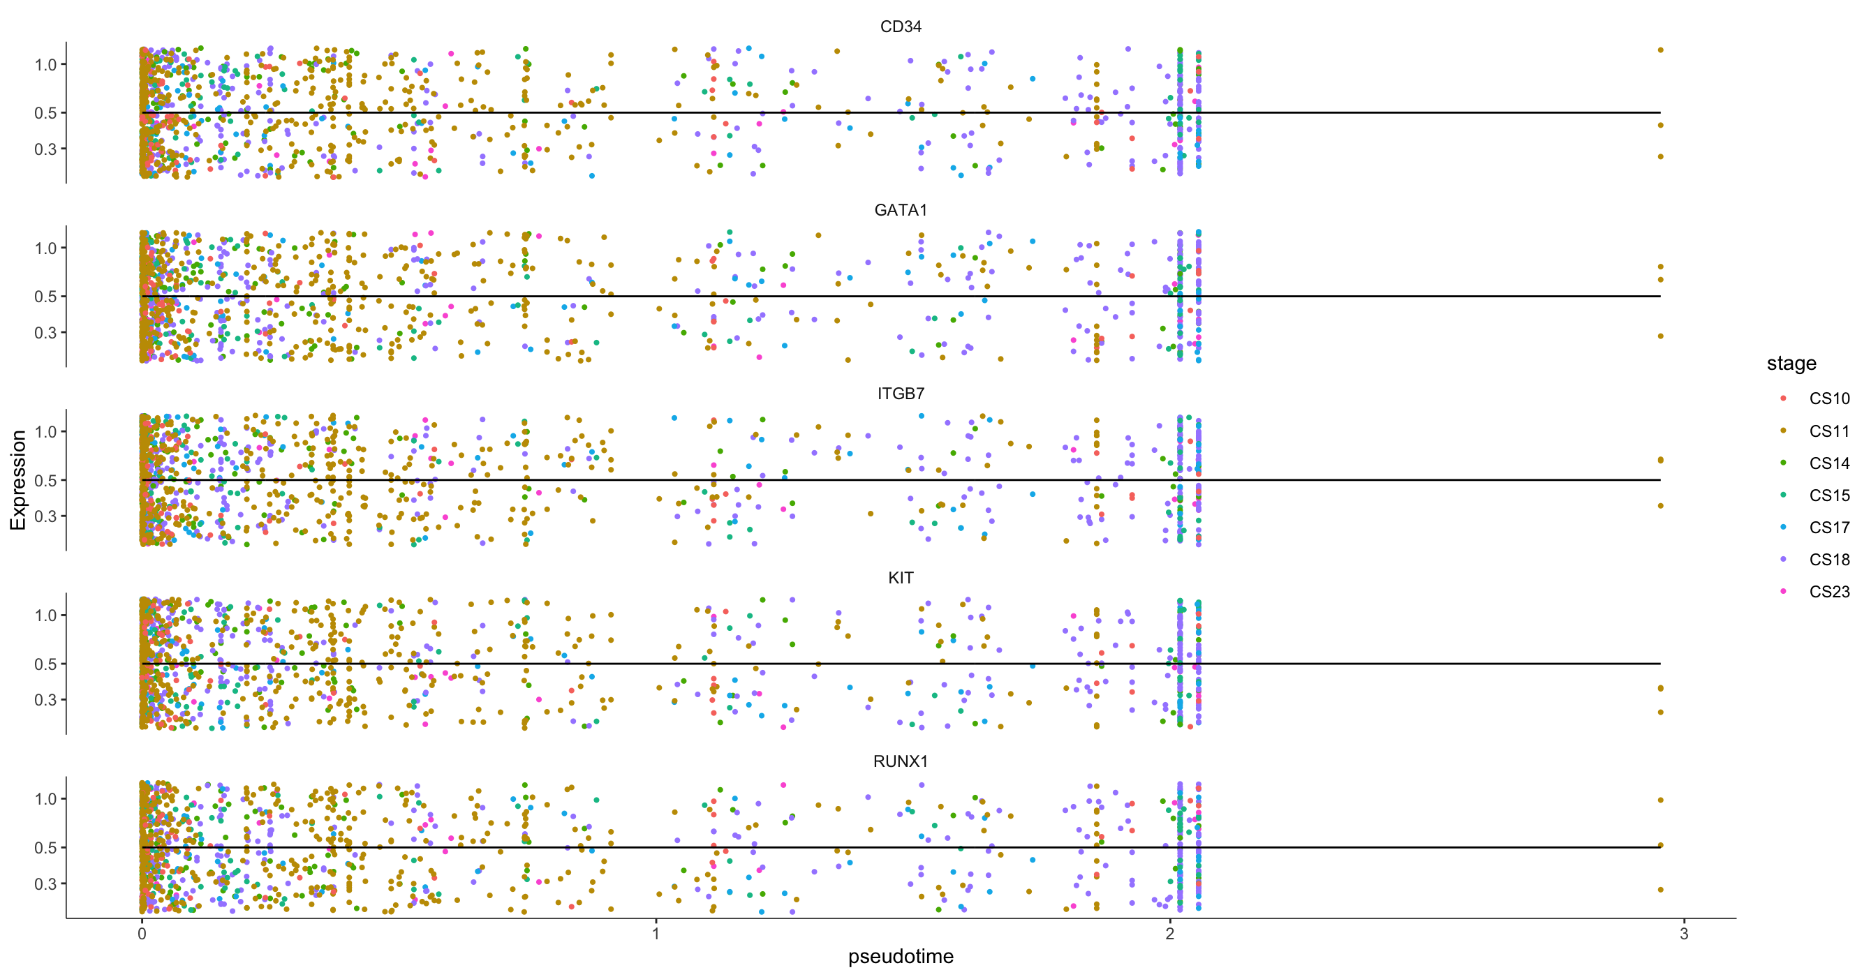
A
B

Slide 12
Integrated based on Component
Integrated based fetal.ids
Integrated based stage of Development
Not Integrated
A
B
C
D

Slide 13
Integrated based on Component
Integrated based fetal.ids
Integrated based stage of Development
Not Integrated
A
B
C
D

Slide 14
Conversion & Sub-setting Data
Preprocessing
Differentially Expressed Genes
Functional Analysis
Normalization
Quality Control
AnnData to Subset h5ad Siles for Mast Cells and Meyloid Progenitors
Seurat to Find all Markers
Filter for two-fold change
GSEA
Integration
→
→
→
+
Data Already Had Some QC Conducted
Harmony
Dimensionality Reduction
→
+
Or
+
+
→
+
Pseudotime Trajectory: Monocle 3
Conversion of h5ad Files to Matrices
Seurat Anchors
Filtering Based on MT%, nCount, and nFeature
Clustering & Finding Neighbors
→
Non-linear Dimensionality Reduction: UMAP
Cluster Cells
Comparison of Clusters
Trajectory Analysis
→
→
→
→
+
+
Conversion of Matrices to Seurat Object
Set Covariates
Figure 1: Analysis Pipeline Overview

Slide 15
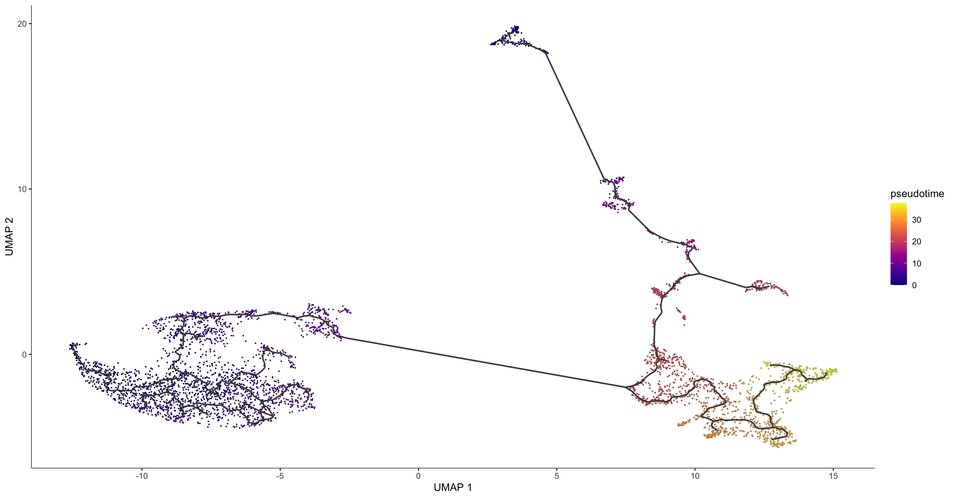
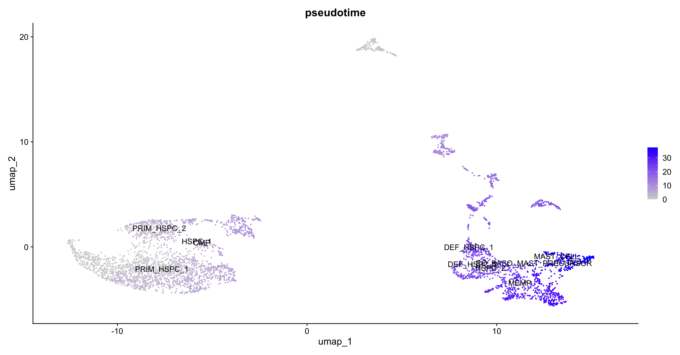
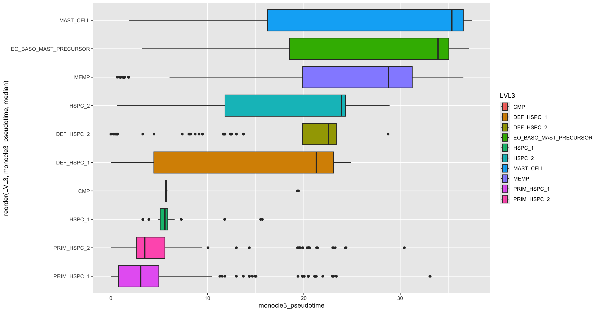
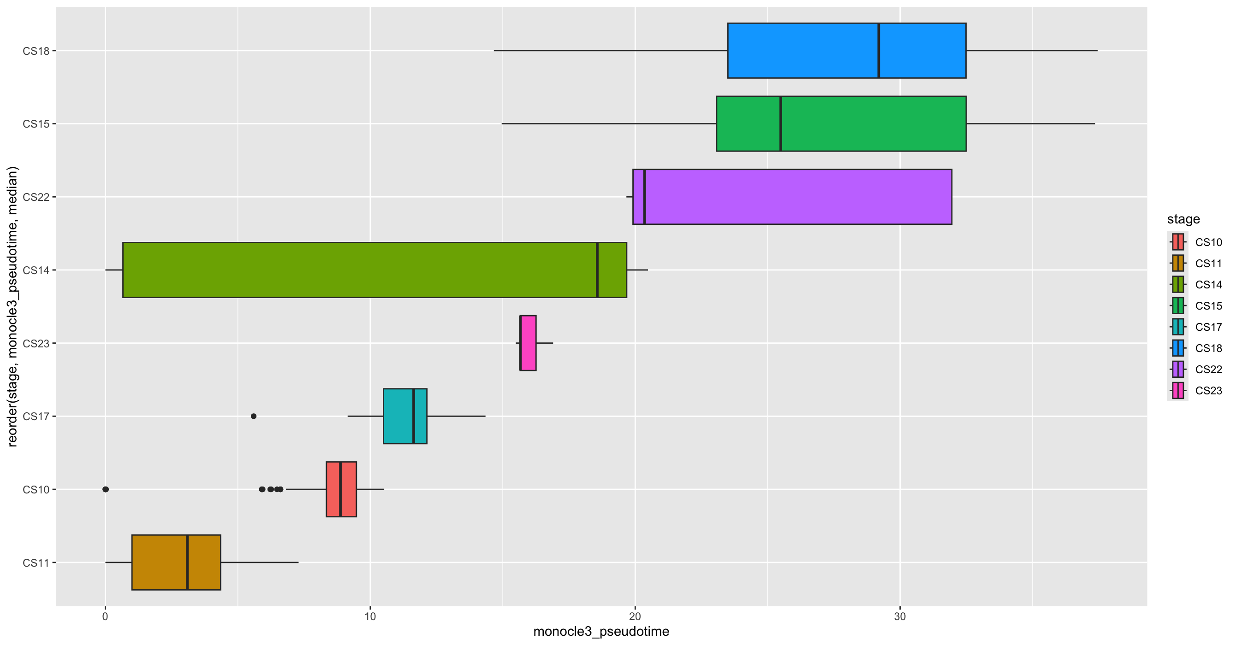
A
B
C
D

Slide 16
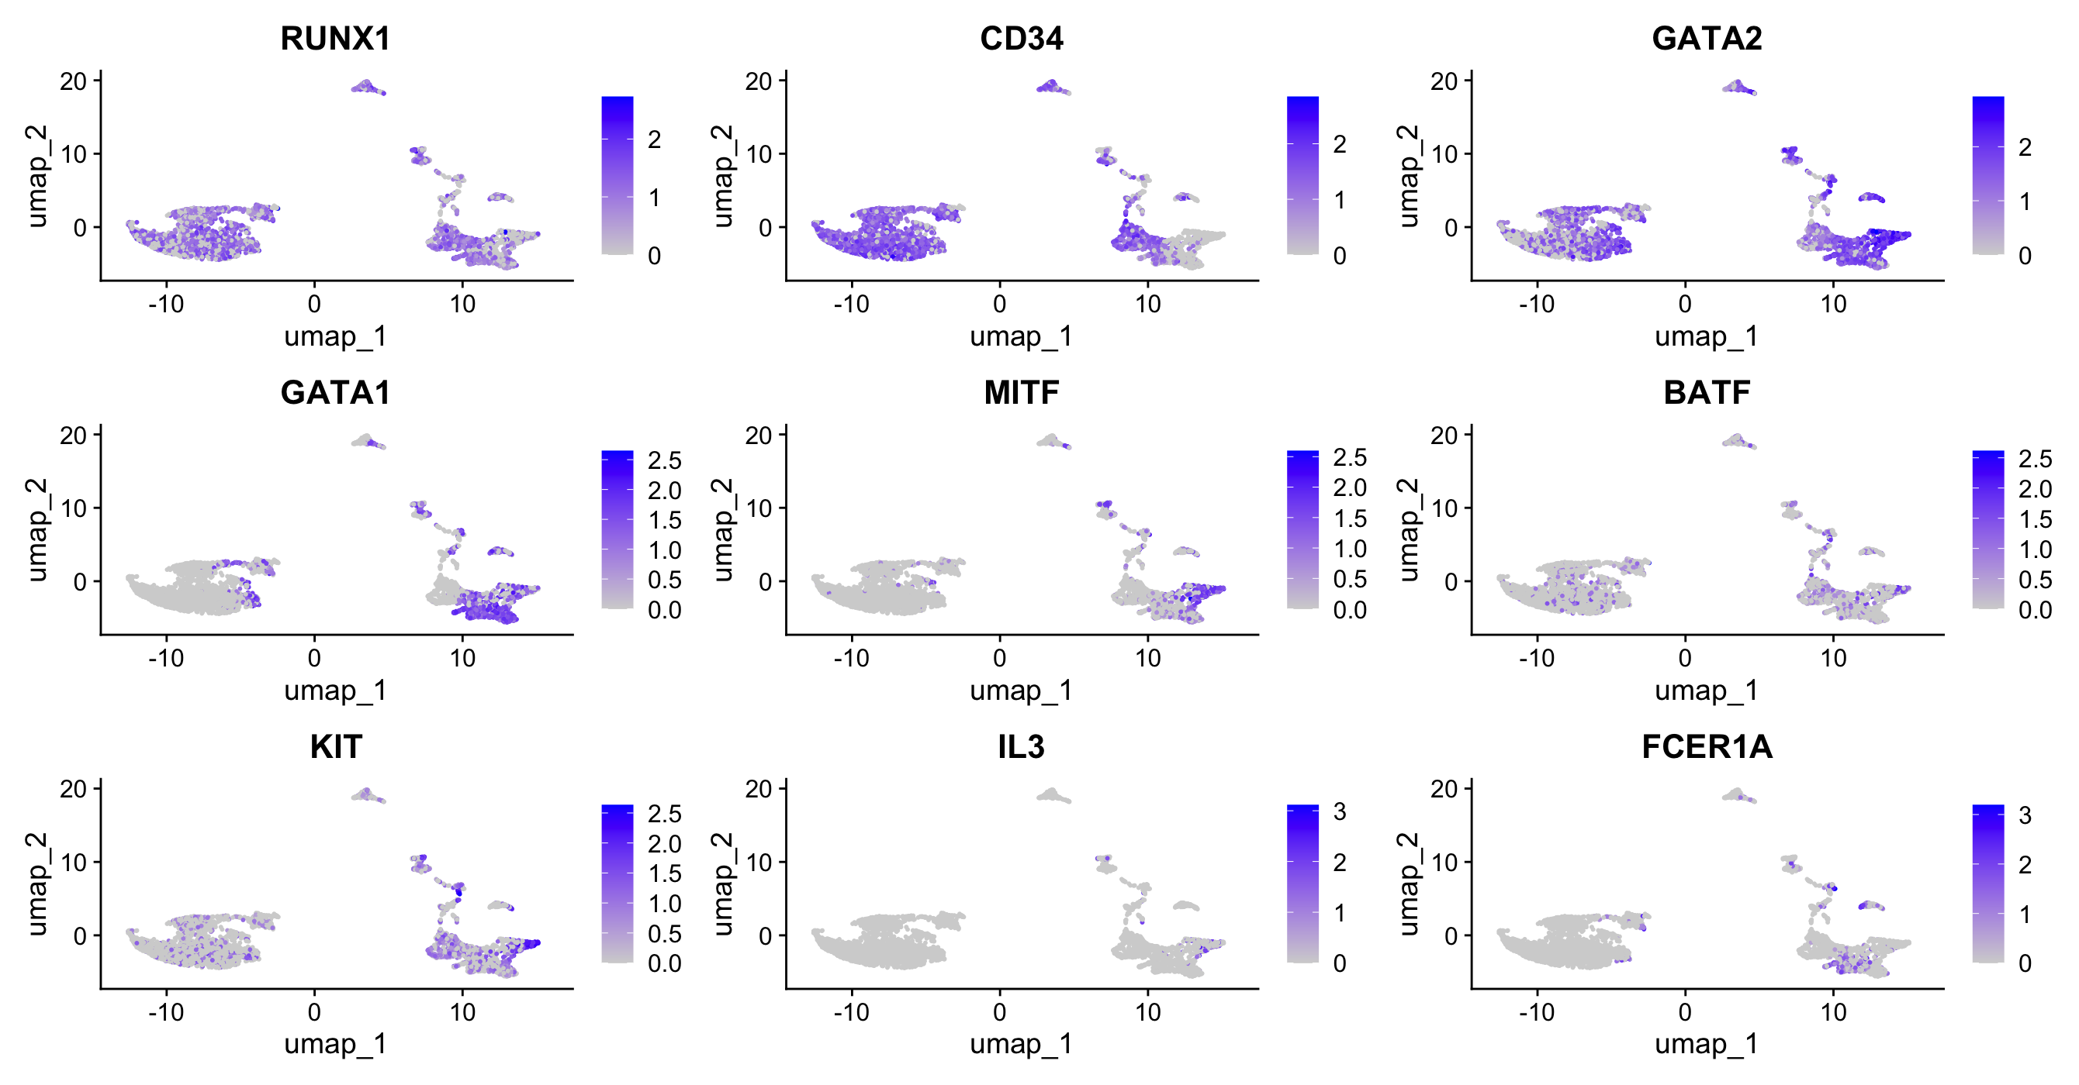

Slide 17
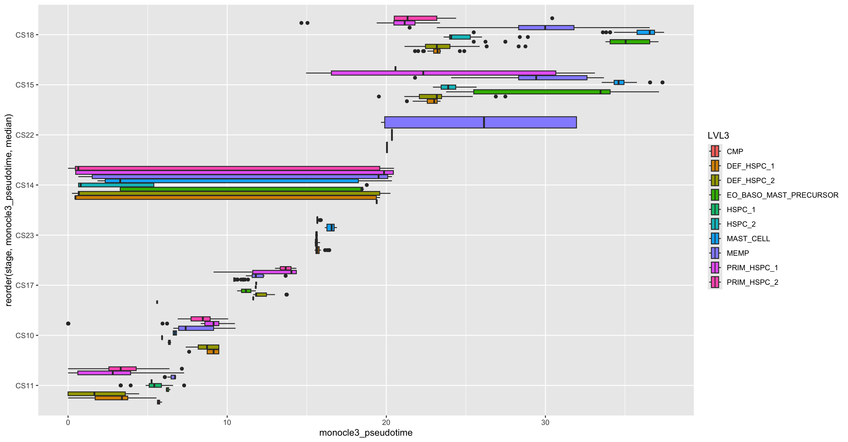
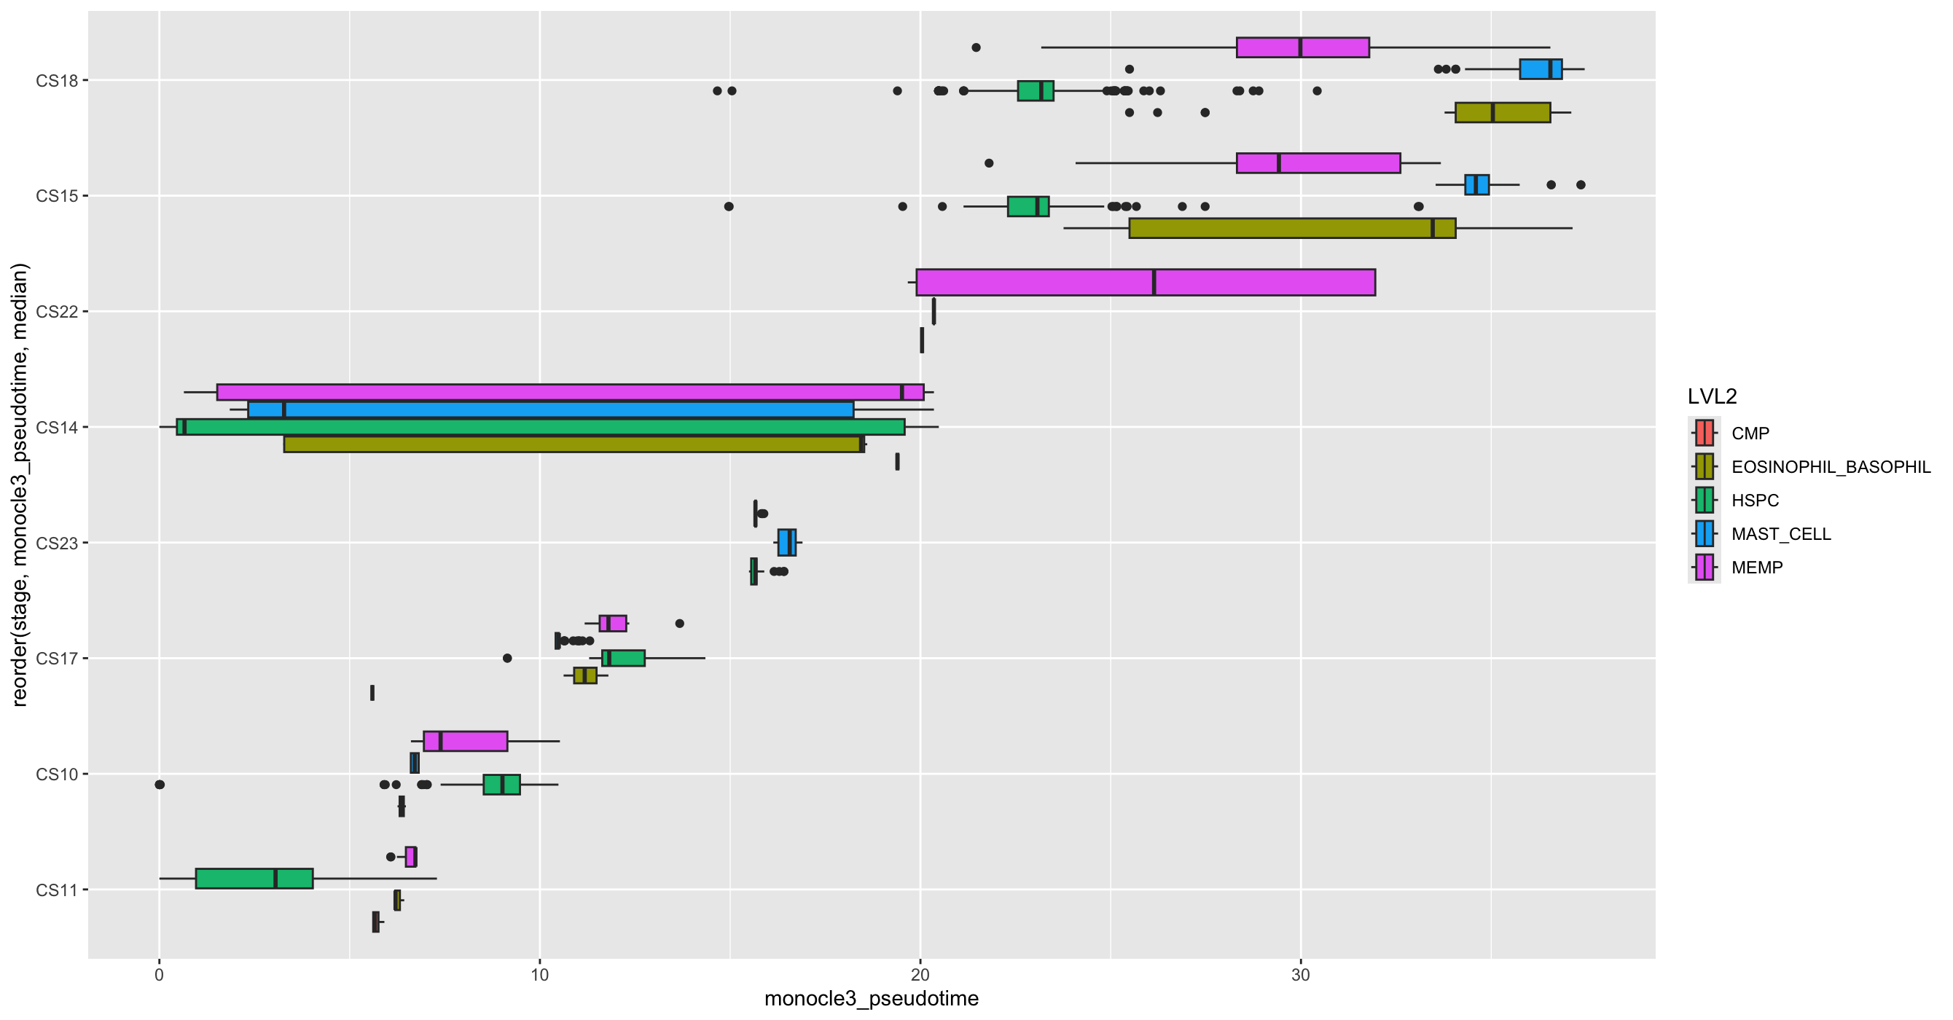
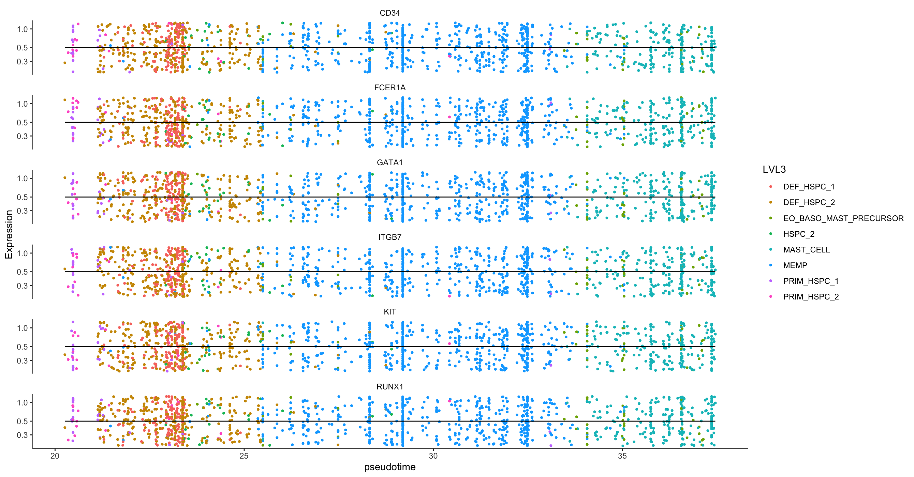
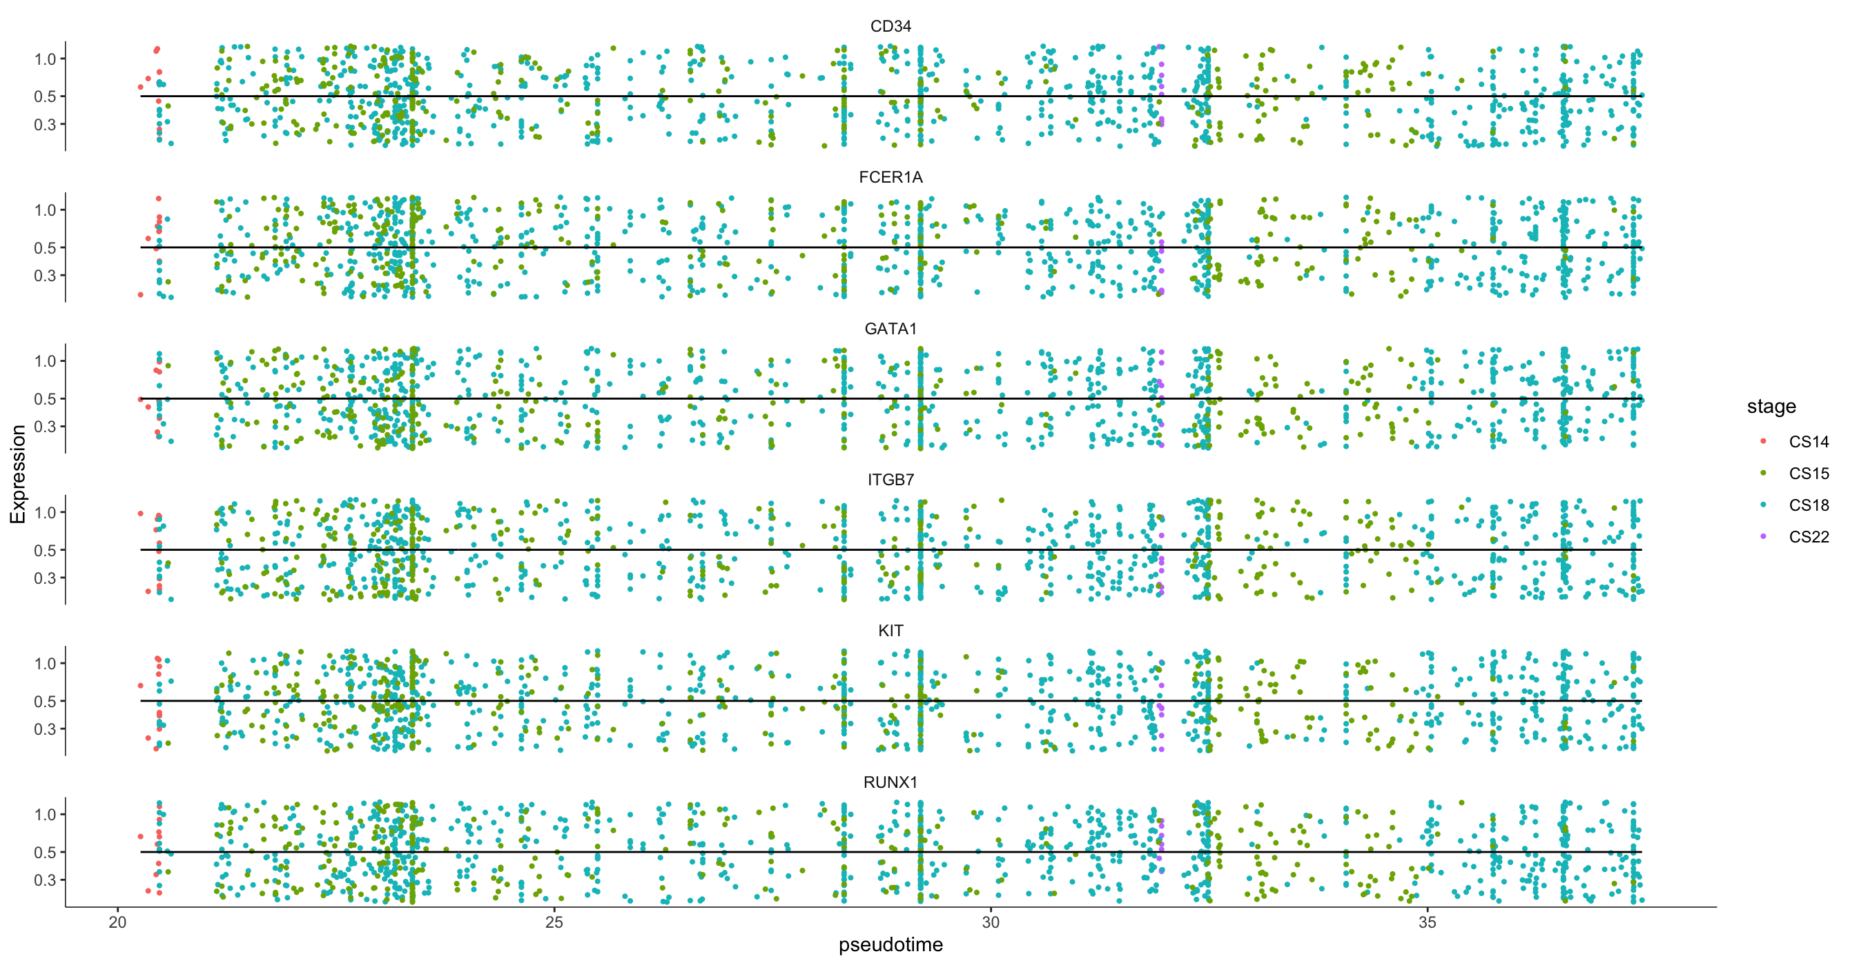
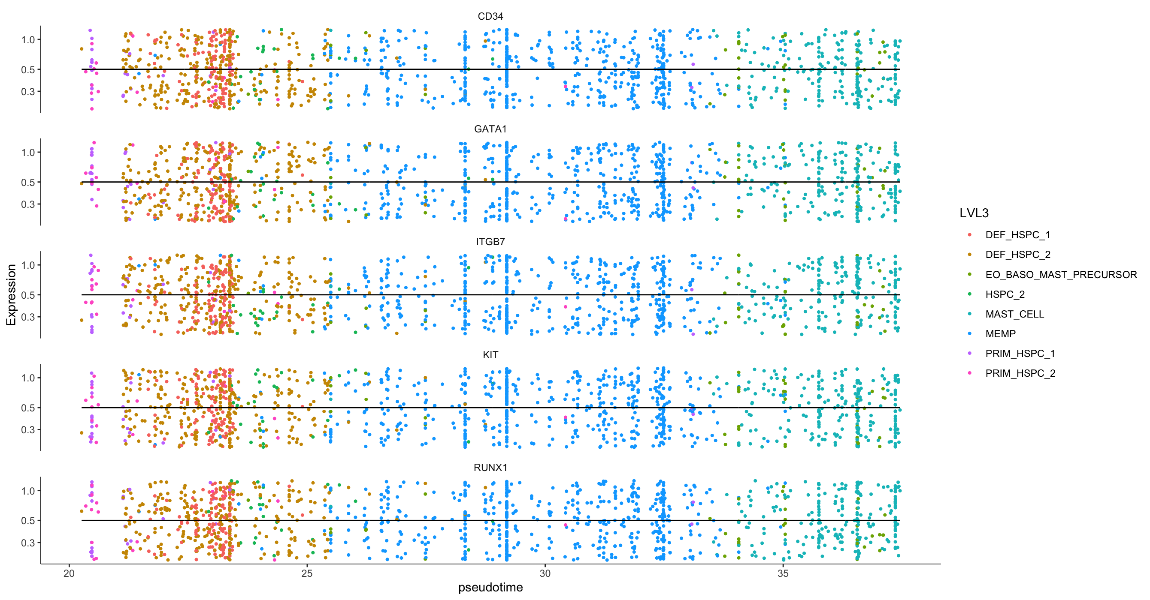
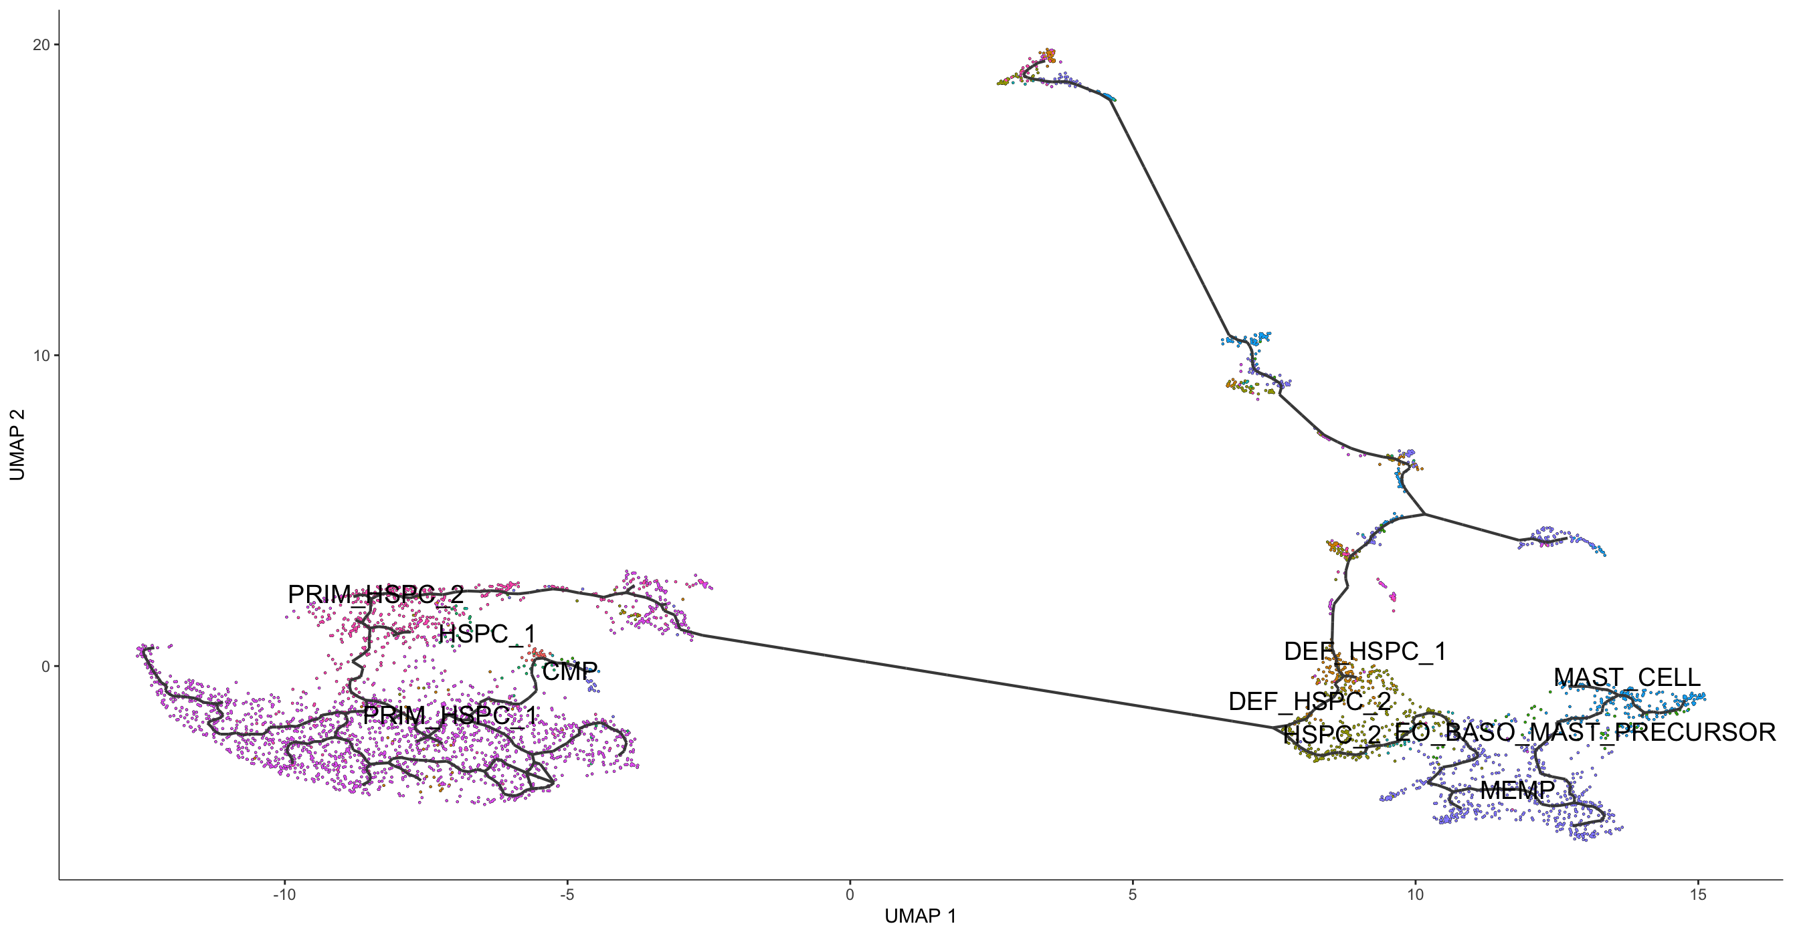
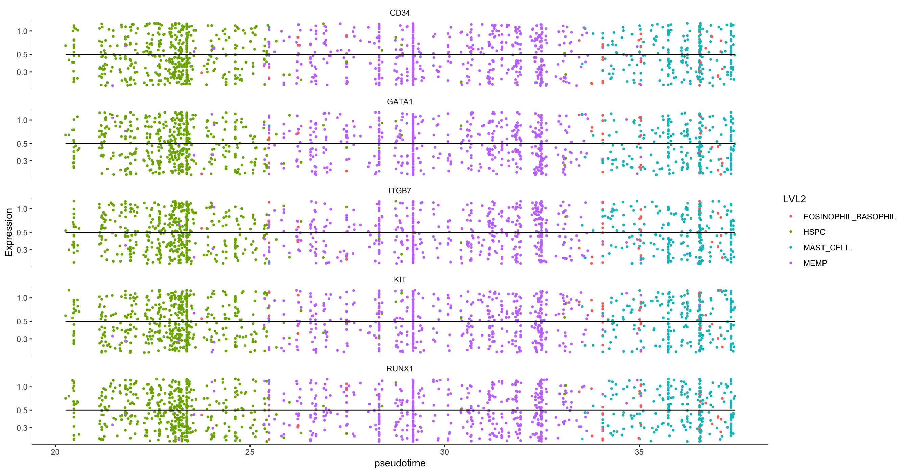

Slide 18
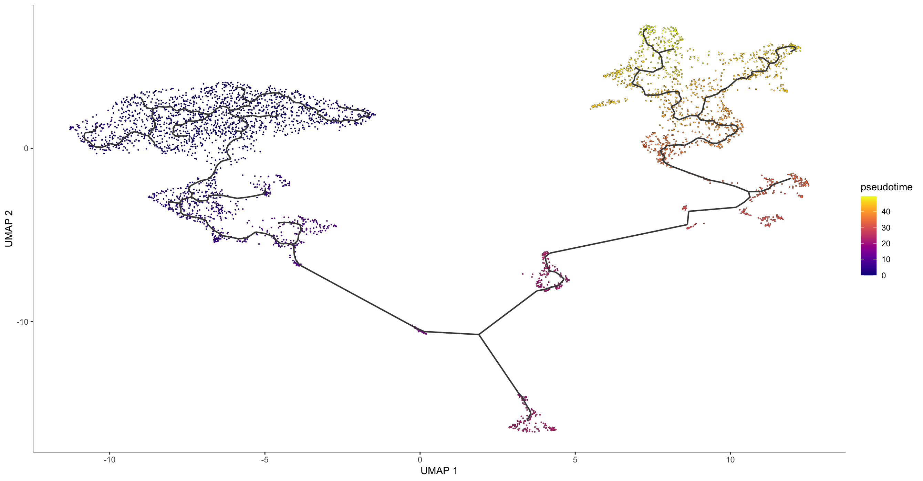
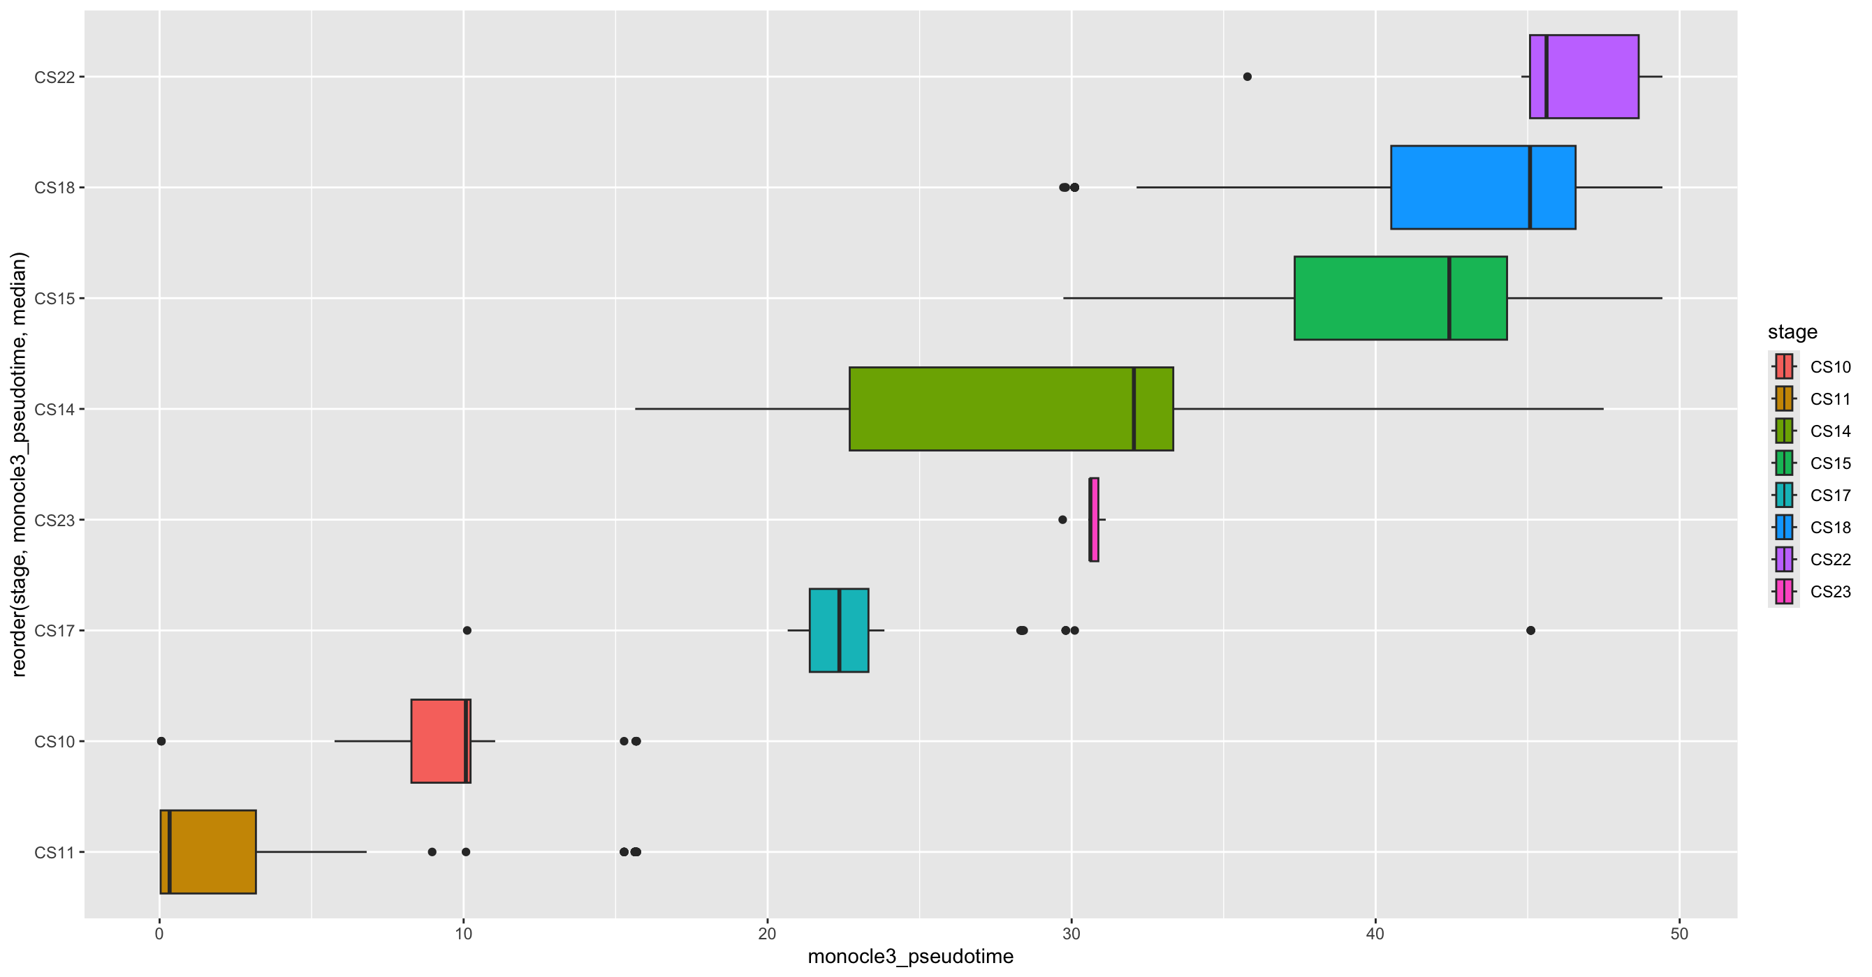
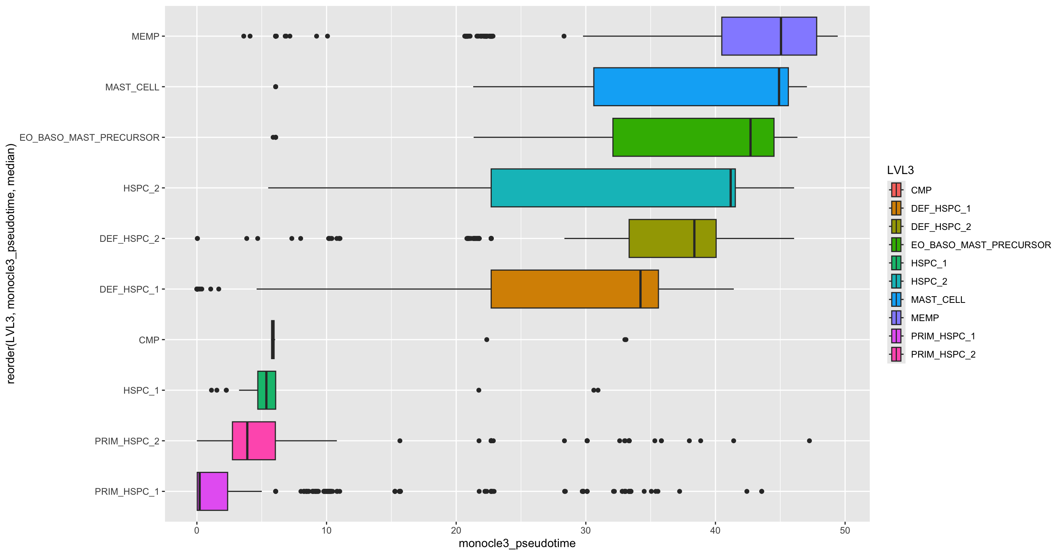
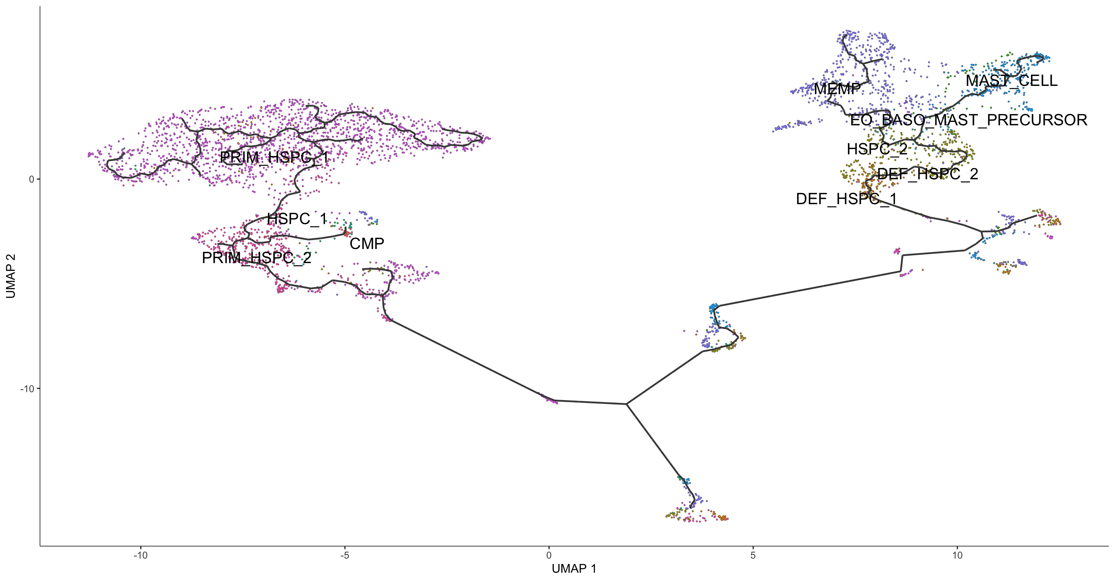
A
C
D
B

Slide 19
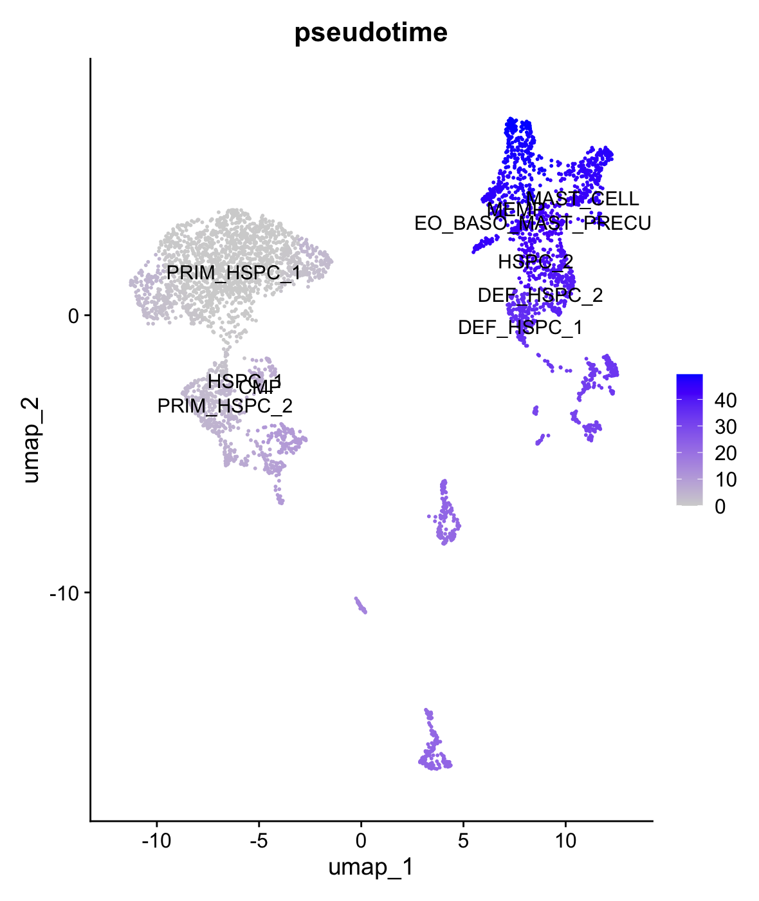
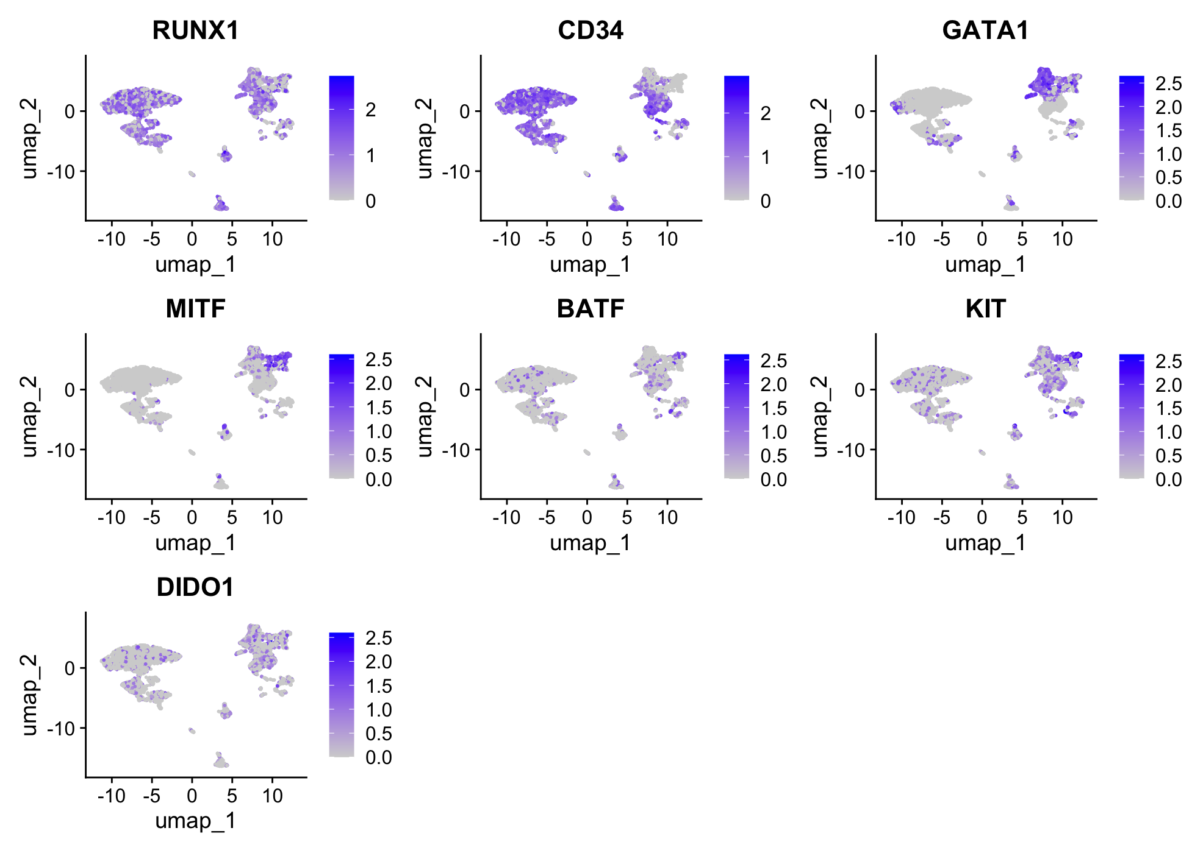
A
B
RUNX1 = transcription factor involved in hematopoiesis
CD34 = cell surface glycoprotein expressed on hematopoietic stem cells and progenitor cells
GATA1 = transcription factor that plays a critical role in erythropoiesis and megakaryopoiesis
MITF = Microphthalmia-associated transcription factor) is a transcription factor that plays a critical role in the development and function of melanocytes, osteoclasts, and mast cells
BATF = (Basic leucine zipper ATF-like transcription factor) is a transcription factor involved in immune regulation
KIT = receptor tyrosine kinase involved in the regulation of cell survival, proliferation, and differentiation, particularly in hematopoietic stem cells, mast cells, and germ cells
DIDO1: Developmental Transcription Factors

Slide 20
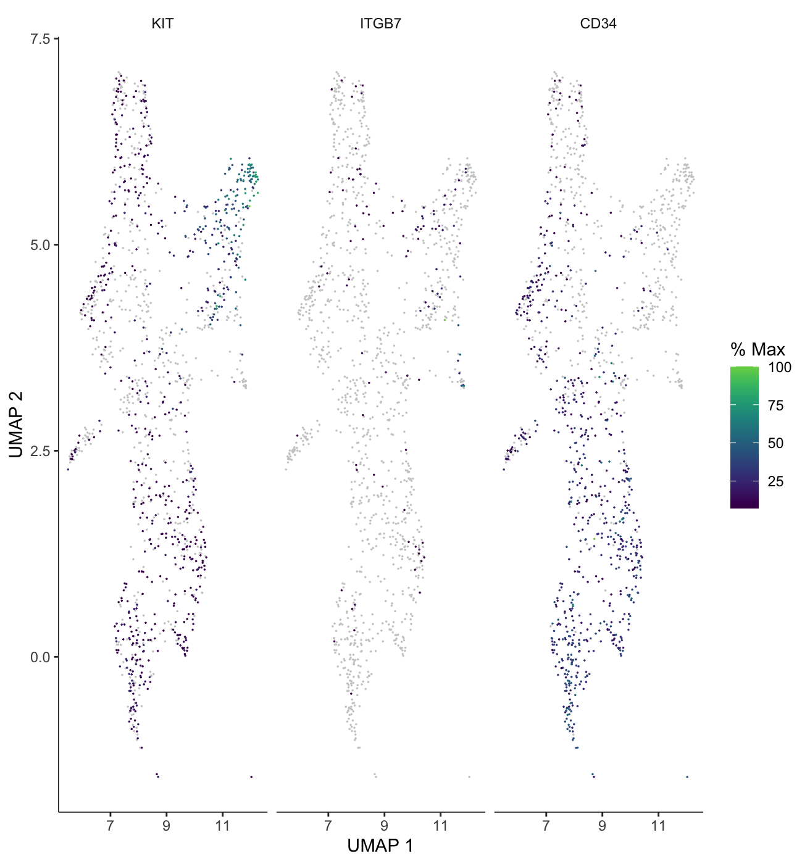
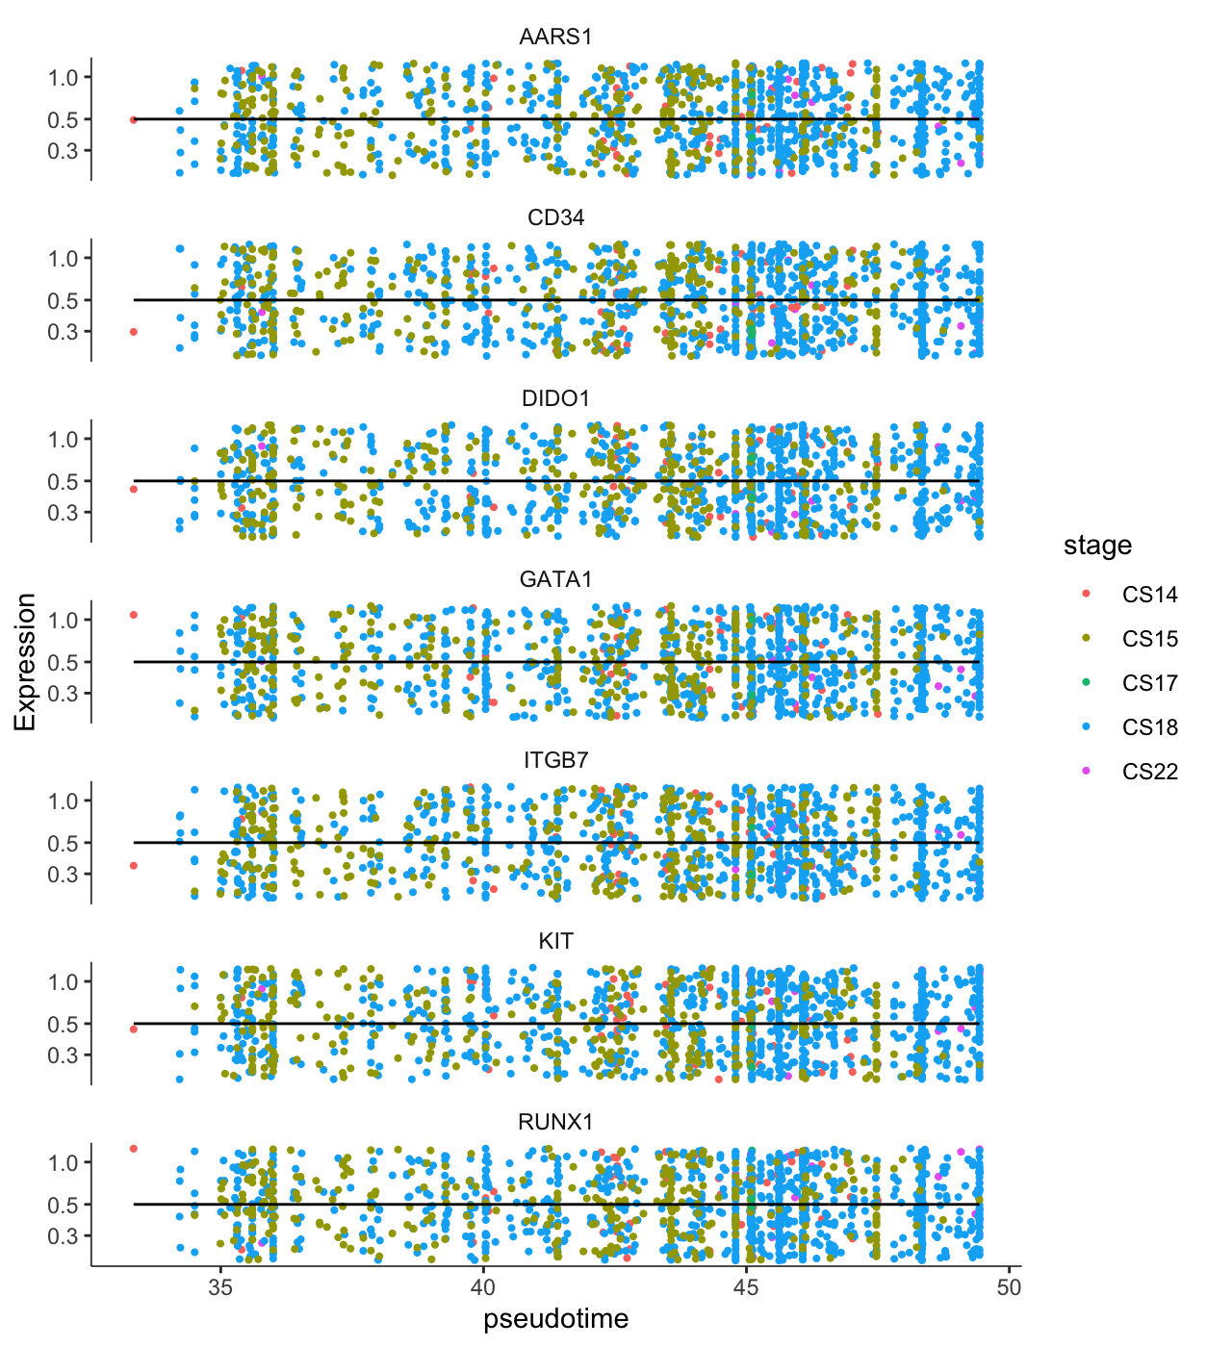
A
B
Most
Least
Expected appearance based on differentiation

